Slide 1

Community Energy Futures
Making It Happen

Slide 2
Aims
Raise awareness of local energy planning methodologies / approaches and discuss how this fits with local energy systems changes
Share experiences of effective approaches to community engagement on the coming changes to the energy system and discuss how this could work effectively
Explore funding that could be available for local energy planning, community engagement, innovation projects and taking identified projects forward

Slide 3
Local Energy Planning

Slide 4
What are we going to cover?
Local energy planning in a local energy systems context
Local energy planning approaches
The experience of engaging in these in a rural and urban setting

Slide 5

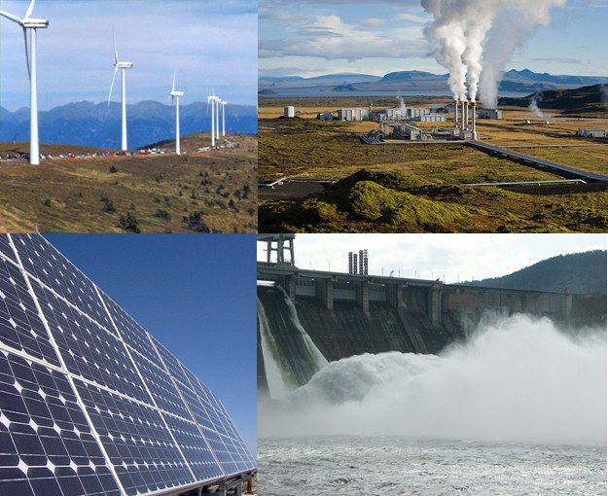


Local energy plans - local energy systems
Now …..
…..Future

Slide 6
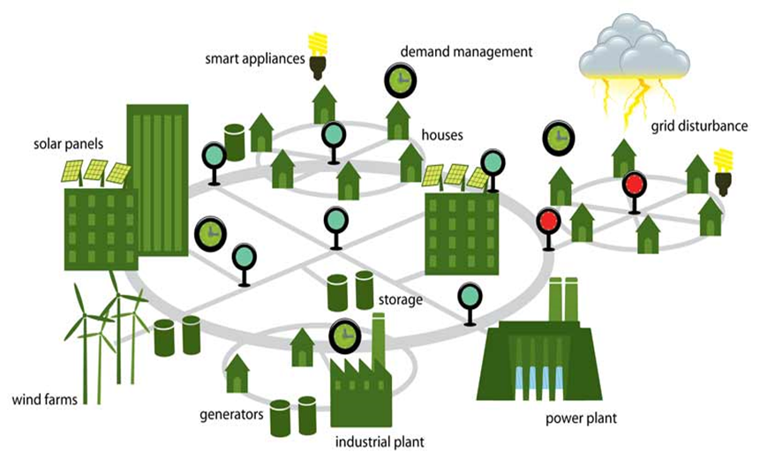
Local energy plans - local energy systems

Slide 7
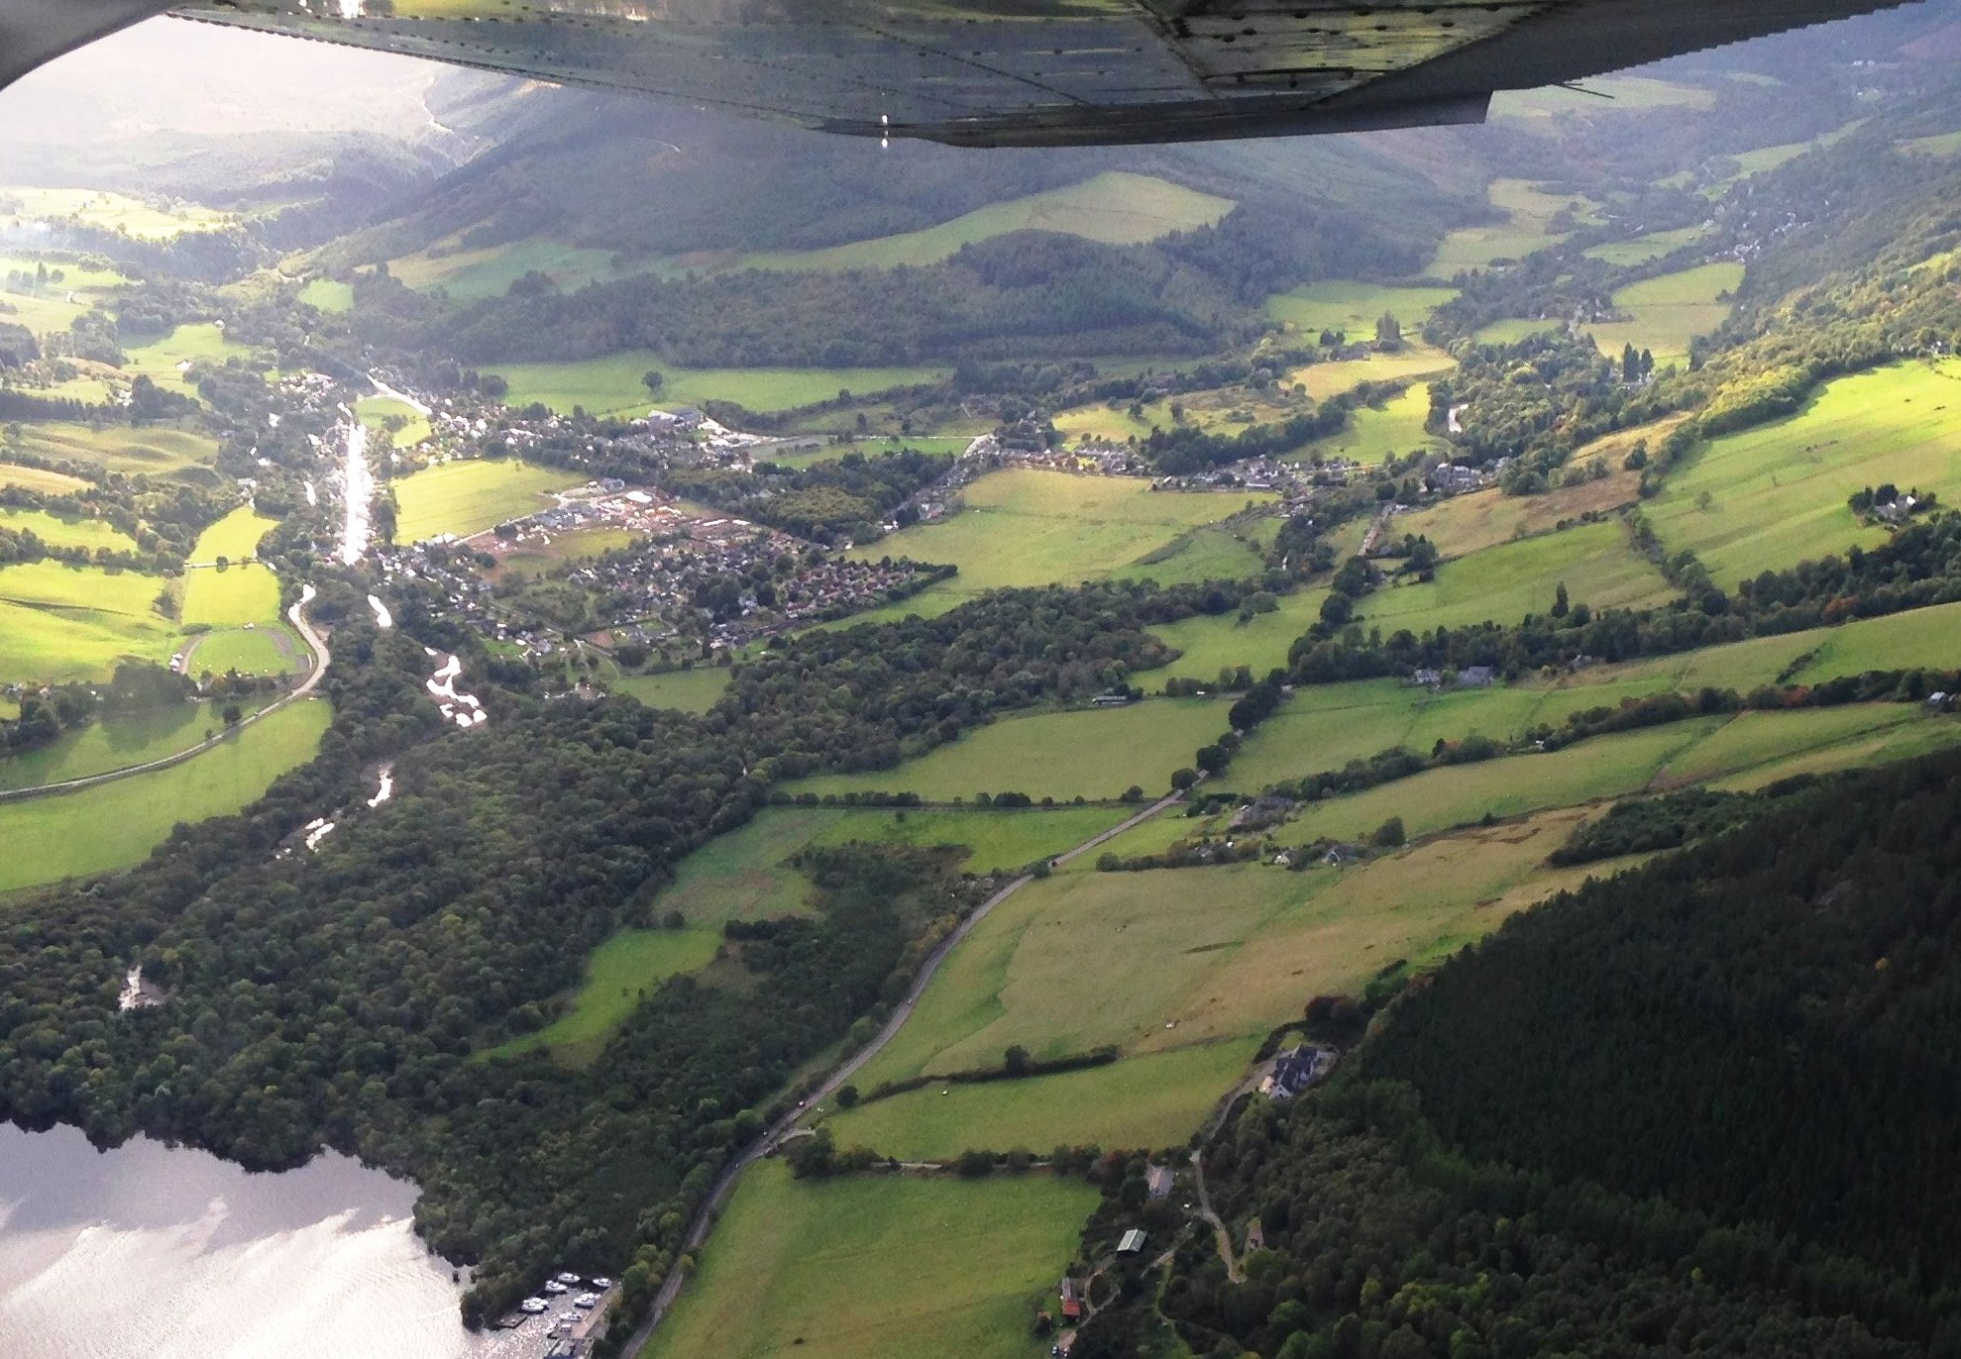


Approaches to Local Energy Planning
5 December 2019
Ross Jones
Local Energy Scotland

Slide 8
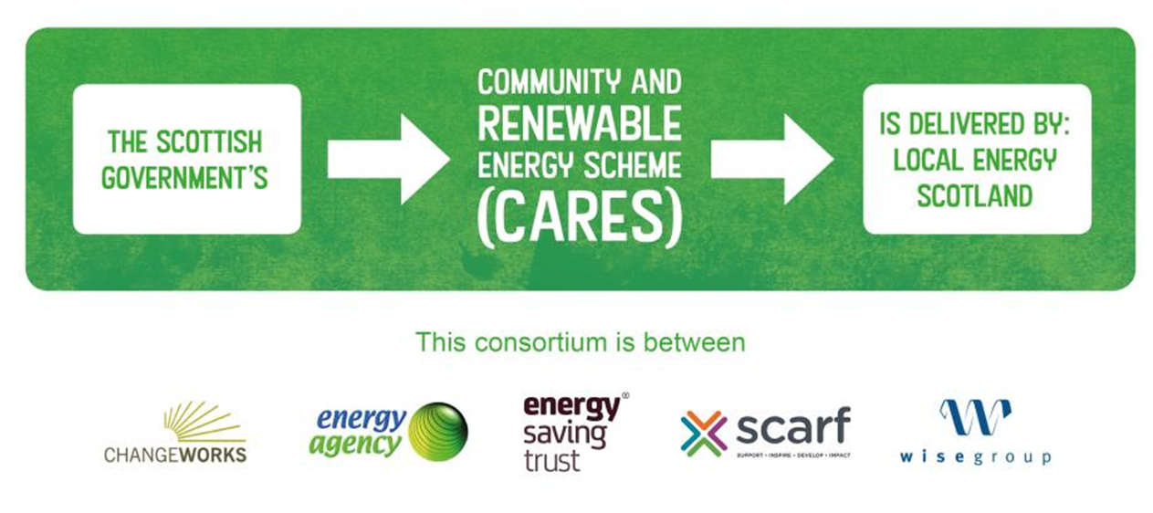
About us
8
Notes:
NEXT slide
We deliver the Scottish CommunityARES that helps local communities
Develop
Paterner in
And Benefit
From renewable energy projects that use their local resources.

Slide 9
Approaches to Local Area Planning
Local Heat and Energy Efficiency Strategies (LHEES)
Focussed on where the Scottish Government have devolved powers. Proposal to legislate as a statutory minimum for local authorities to undertake a long-term plan for heat decarbonisation and energy efficiency.
Local Area Energy Plans
Predominantly local authority led and covers the whole of the energy system ¹ in a specific area with wider stakeholder engagement. Decision to undertake one will be determined by the local stakeholders.
Community-led Local Energy Plans
Created by communities and designed in-line with local needs. Covers the whole of the energy system ¹. Typically focusses on smaller geographical areas. Sets out the key priorities and opportunities. Places these in the context of local and regional planning processes.
¹ whole energy system = electricity, heat, transport
9

Slide 10
Approaches to Local Area Planning
Scottish Government identify six stages to building an integrated plan:
1 | Assessment of local & national strategies and data availability
2 | Area-wide assessment of existing energy resource through stakeholder engagement
3 | Area-wide setting of future local energy targets
4 | Socio-economic assessment of identified solutions
5 | Local stakeholder engagement to inform selection of areas/prioritisation of opportunities
6 | Costing & phasing of delivery programmes in partnership with local stakeholders
10

Slide 11
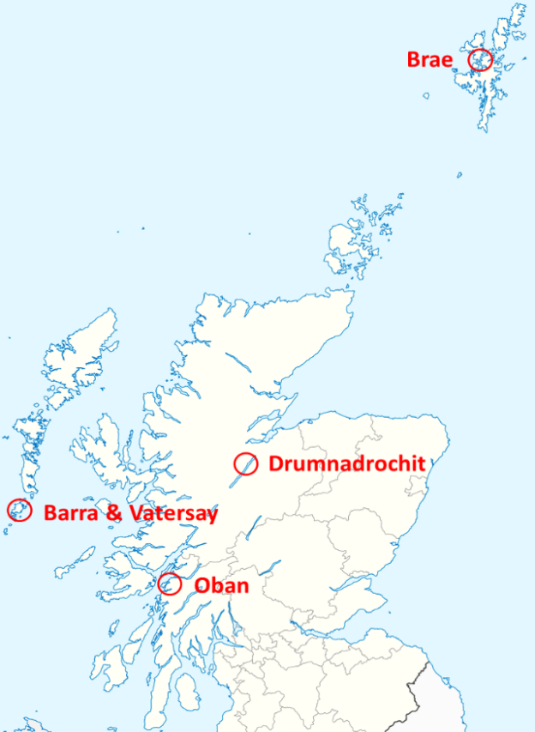
Community-led Local Energy Plans
COBEN: Delivering COmmunity BENefits of Civic Energy
EU Interreg North Sea Region funded pilot with 50% match funded by Scottish Government: Nov 2016 – Mar 2020
    Pilot across 4 locations in Highlands and Islands to:
    provide an evidence base which demonstrates the benefits of community-led local energy planning
    develop a consistent and flexible methodology that can be replicated and toolkit to support this
Location | Pop | SG Urban/Rural 8-fold
Brae | 700 | Very Remote Rural
Drumnadrochit | 1700 | Accessible Rural
Barra & Vatersay | 1300 | Very Remote Rural
Oban | 8600 | Very Remote Small Town
11

Slide 12
Community-led LEPs provide an opportunity to:
understand energy use and tackle wider issues around fuel poverty, economic development, capacity building, etc.
identify projects that respond to local community and energy system priorities
provide an evidence base to take forward energy projects with a community and energy system mandate
demonstrate a shared community voice
add value to local development strategies such as:
- Local Heat and Energy Efficiency Strategies (LHEES)
- Local Area Energy Plans
- Community Action Plans
12

Slide 13
Community-led LEP Model
Taking
the plan forward
Initialising
Development can be considered as part of six inter-linked stages with the community at its core.
Plan development
Mobilisation
Community
Options appraisal
Data gathering
13

Slide 14
Options appraisal – a process
Direct
Community priorities
+
Review of energy systems
and demand/supply
Options
to take forward
- Behaviour
- Efficiency
- System change
Economic
Prioritised
list
Indirect
Social
Strategic
Net benefits
14

Slide 15
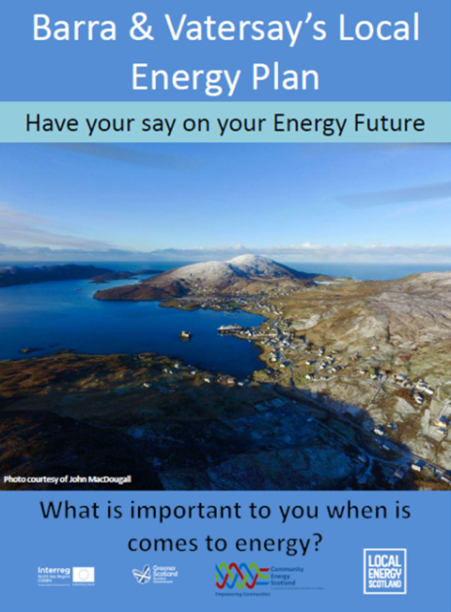
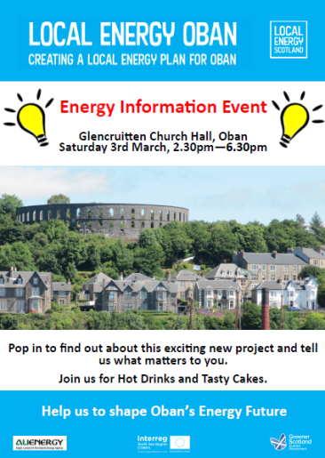
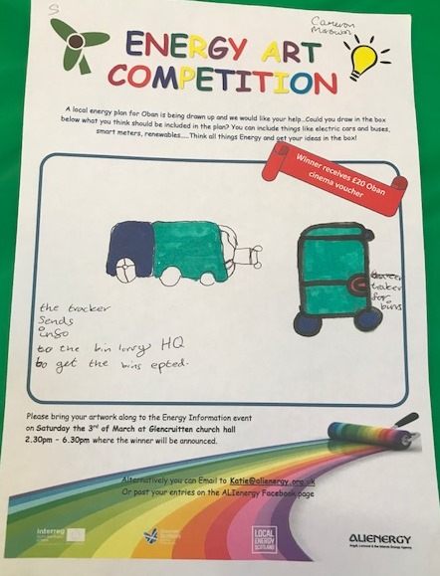
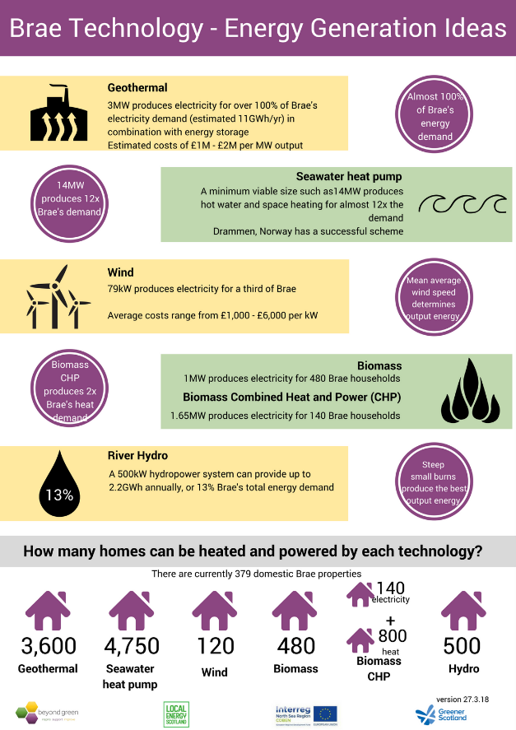

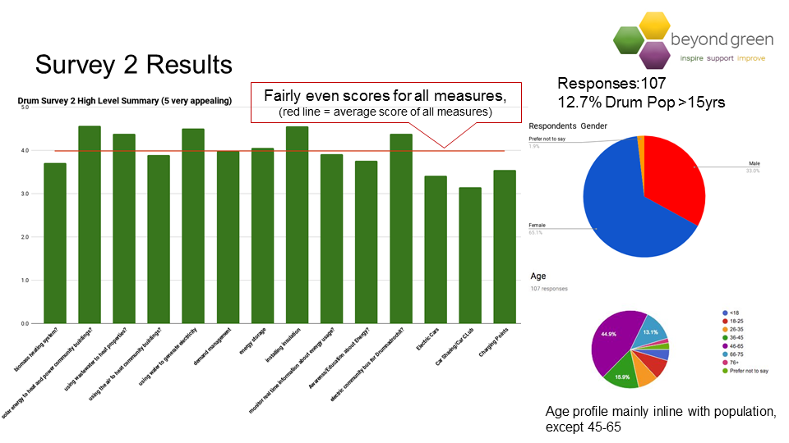
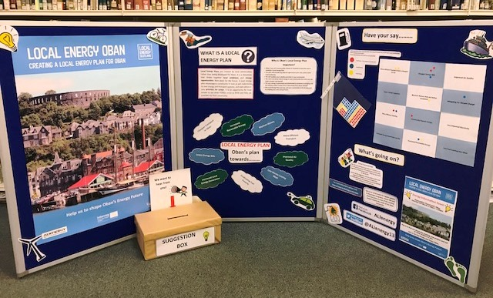
Community engagement is key
15

Slide 16
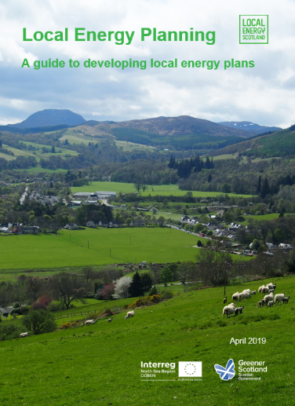
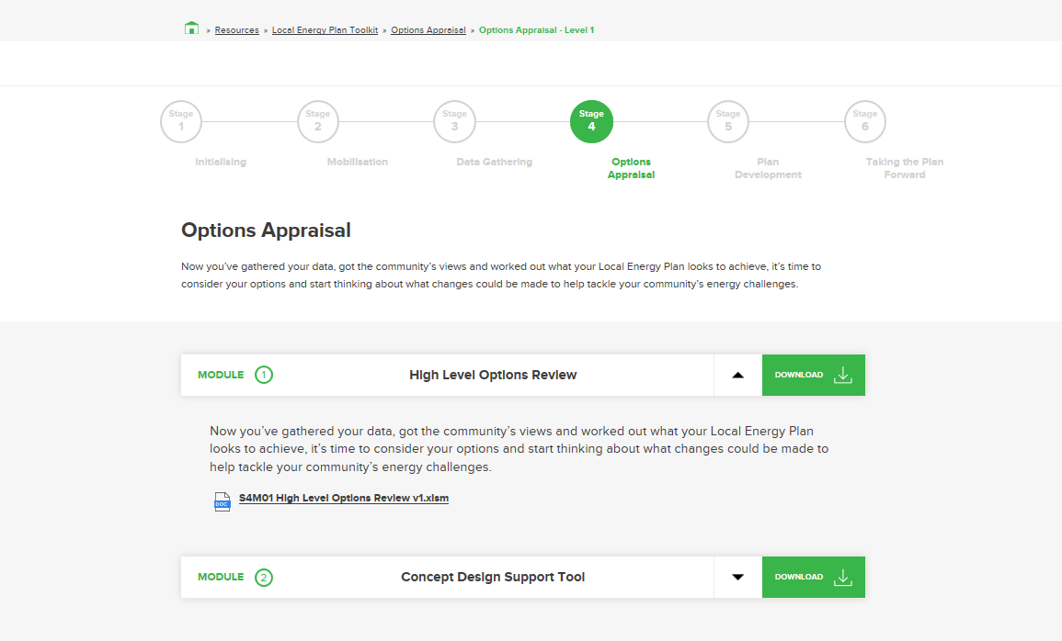
Guide to local energy plans and toolkit
Available through website and supported by toolkit:
Explains how you can create you own LEP and covers every step in the process
https://www.localenergy.scot/what-is-local-energy/local-energy-plans/
16

Slide 17
Looking ahead
Proposal submitted to Scottish Government to support a number of new Community-led LEPs through CARES.
Any decision will wait until after the Scottish Government’s Local Energy Policy Statement is issued (expected Feb 2020). Statement will set out the Government’s position. Consultation ended on 4 Dec 2019.
Proposal is for:
  a lead organisation
  to use guide and toolkit (help guide contracted consultants)
  2 stage process
    Stage 1 – concept of accelerating progress to net zero emissions
    Stage 2 – define the proposed process, programme and outline costs and include evidence on local participants and other (wider) committed support
Communities can use guide and toolkit to develop local energy plans
17

Slide 18
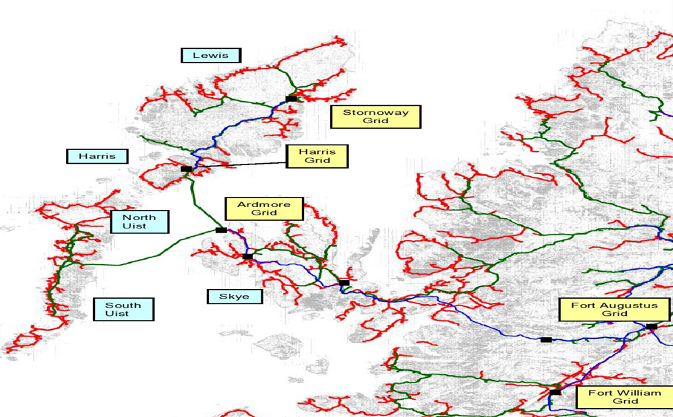
Barra & Vatersay Local Energy Plan
Euan Scott, Project Co-ordinator at Barra and Vatersay Wind Energy Ltd
Barra

Slide 19

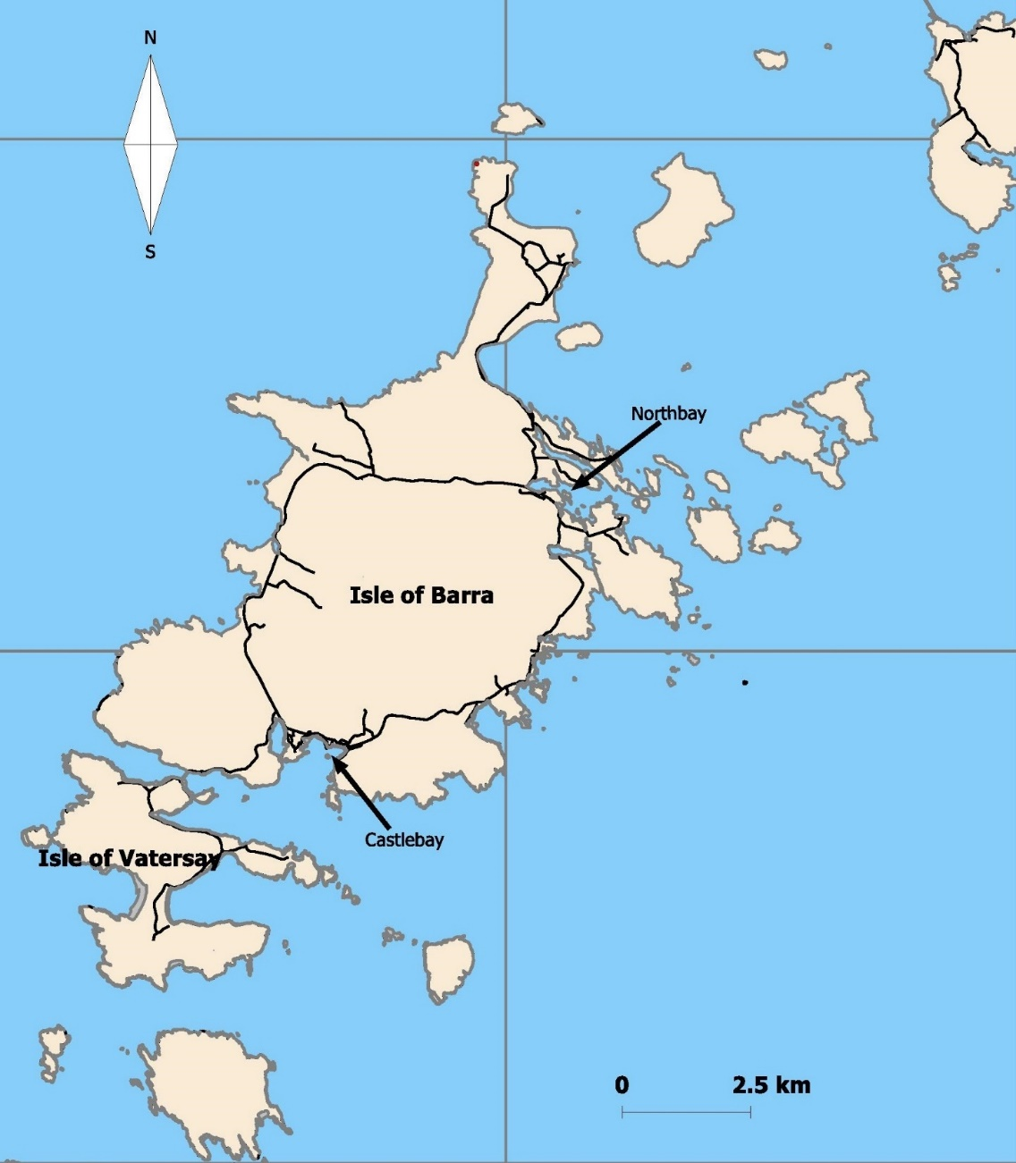
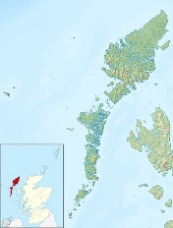

Locality
Key Statistics
OS grid reference NF687004
Coordinates 56.9833°N 7.4667°W
Area 22.7 square miles
Council area Na h-Eileanan Siar
Population 1,264
Population density 19.98 people/km2
Households - 587 (720 CnES)
Average household size - 2.15 people
Broad age groups:
  Under 16 - 20.3%
  16 to 64 - 58.7%
  65 and over - 21%
Economically active - 70%
Source: National Records of Scotland www.scotlandscensus.gov.uk

Slide 20
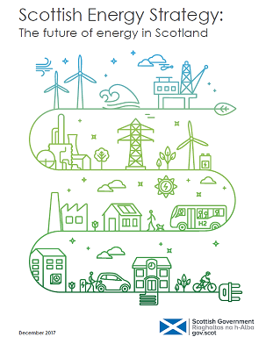

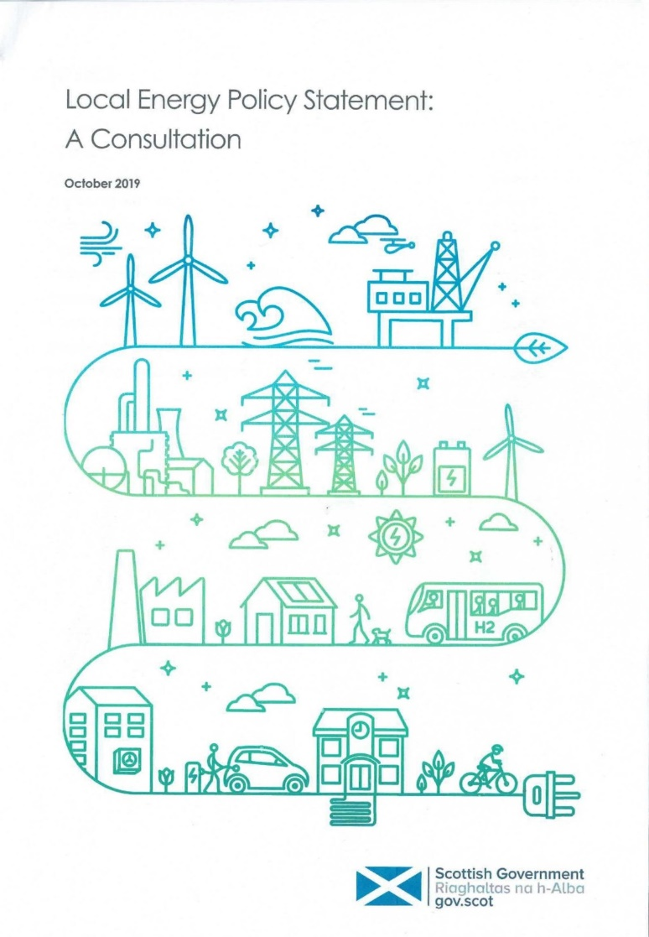



Changing strategic landscape
Climate emergency
Net zero targets
Is it changing? Who and what are the agents of change?
Community energy is the delivery of community-led renewable energy projects, whether wholly owned and/or controlled by communities, or through partnerships with commercial or public sector partners
1/6 strategic energy priorities in Scotland’s Energy Strategy: to empower our communities by supporting the development of innovative & integrated local energy systems and network
Local energy is more wide ranging, involving a range of different organisations [public & private], who are delivering an energy service for the benefit of local consumers operating within a defined geographic area.
SG recognises that local energy cannot be delivered in isolation: it will develop alongside (and within) a vibrant national energy network.
Notes:
SCOTLAND’S ENERGY PRIORITIES THE 2050 VISION IS BUILT AROUND THE FOLLOWING SIX PRIORITIES: Consumer engagement and protection, Innovative local energy systems, Energy efficiency, Renewable and low carbon solutions, System security and flexibility, Oil and gas industry strengths

Slide 21
What is a Local Energy Plan?
Are the community sufficiently well informed of the options and the changing policy/strategic landscape?
created by local communities
designed and developed in line with local need
a ‘whole-system’ view to include power, heat, transport, demand management and storage, energy efficiency
sets out the key priorities and opportunities that will promote the development of local energy systems
places these in the context of planning processes that are developing as part of regional and national strategies
Local Energy Systems are ones which find ways to link supply and demand of energy services within an area across electricity, heat and transport, delivers real value to everyone in local areas and support the growth of vibrant, net zero local economies.

Slide 22

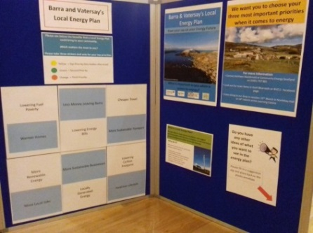
Community Engagement
(supported by Community Energy Scotland)
Focused on two community events supported by a survey.
Information displays in public buildings and promotion through local and social media.
Material has been created by CES to support process.
First event held as drop in events in Northbay and Castlebay and two workshops at the school.
Second event was a workshop to explore priorities and feedback on the draft plan.
World-cafe format: after an introduction split into tables of 4 and 5 to discuss, agree and rank responses to a number of set questions and during the process agree the major issues and solutions. Different events should follow the same format so the responses and outputs can be collated across events.

Slide 23
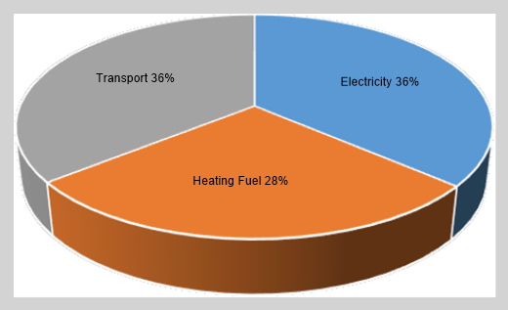
Energy audit (baseline) – the market
Community wind turbine generates around 3.3GWh/yr (of which 0.5GWh/yr curtailed as a result of scheduled outages).
Annual estimated total energy demand
TOTAL (all sources)
Grid export limit is subject to G83 (3.68kW per phase) and additional renewable assets are not permitted without associated new demand but there is scope for far greater penetration if supplemented by storage.
Nested within this the 900kW community turbine is curtailed to 0MW when ‘islanded’ and local demand is met using diesel generation.

Slide 24
Challenges/drivers
Focusing on the issues and constraints.
High levels of fuel poverty: Comhairle nan Eilean Siar region has an average fuel poverty rate at 56% (Scottish House Condition Survey, 2016)
Inefficient energy consuming housing: 55% of dwellings are assessed as being in the least efficient Energy Performance Certificate (EPC) rating bands (E – G) 51% of dwellings are 35 or more years old.
High levels of electric & oil heating: 46% of dwellings use electric heating; 49% use heating oil
These are fuels with expensive tariffs for households
Grid constraint (& curtailment) for larger local generation assets: Present capacity limits the size of local generation, such as wind turbines, that can be connected to the local grid
Transport links: 69% of the population are economically active and typically travel to work by car
Affordable ferry and air travel routes to the mainland and other islands are crucial for the whole community
45% of households have access to at least one car or van
Changing working patterns: should community groups get help and support in drafting and submitting applications & ITTs? The proposal can be conceptualised (high level) but the technical detail can be too specialised.

Slide 25
Actions
All very well but where to go from here?
Inaugural meeting of LEP implementation group last week.
Resource constrained: staff & money. Need to engage and align with SG Local Energy Policy & Scottish Energy Strategy, LHEES etc.
Notes:
Whilst there is merit in all the APs it would be good to have a mission statement or at least something short and concise describing the raison d’etre of the implementation group. A self-sufficient local energy economy is probably one set too far. Linking energy to a circular economy is also important (OHLEH). Something along the lines of managing local resources to address local energy needs so as to maximise benefit to the local economy.

Slide 26
Outcomes (ad hoc)
E-vehicle fuel good driver training
Resource Efficient Scotland audit and transport review of Barratlantic Ltd
EST demonstration e-bike
Water Efficiency Project
Participatory GIS PhD study in to footpaths
Hydrogen Event
Stakeholder buy-in?
Herring Walk design study
Uni. of Strathclyde MSc. students group and individual project work
Only one of these was instigated by external parties.
Notes:
ETP are currently in discussions with CARES about taking forward outcomes from ETP-funded modelling and feasibility studies for integrated, multi-vector energy systems.
ETP have also supported submission of a bid into the ERA-NET Smart Energy System Co-fund with Scottish Enterprise’s Integrated Regional Energy Systems Fund. Under this proposal, a Virtual Power Plant ‘Hub’ or SIES Centre would be developed. The SIES Centre would connect a number of distributed energy systems in various locations, as living labs or ‘energy pools’. These energy systems, including Barra & Vatersay, are all proposed as Scottish energy pools. It is our hope, through working alongside LES and CES, that we could support the taking forward the outcomes of the ETP Modelling & Feasibility study.
Proposal for closer-working, collaboration support and inter-agency funding applications and shared learning between island initiatives are proposed.

Slide 27
Outcomes (funded)
COBEN Stream 1 (external expertise and services)
COBEN Stream 2 (capital funding)
Third sector partnerships supported through anchor group
Barra Energy in Motion project:
Rapid DC and slow AC EV chargers interfaced with battery storage and connected to an existing wind turbine
Energy monitoring
7-seater community EV
Supplementing the power supply to the community building and EV-charger with renewable generation and battery storage will reduce the cost of electricity used by the community. The battery storage will utilise the on-site generation otherwise be exported.
EV charging will be provided at a reduced cost
People with EVs will be encouraged to travel to the island
EV charging will encourage secondary spend at the new community centre.
7-seater EV will provide low cost youth transport and reduce multiple independent car journeys
Vehicle based at point of demand as opposed to destination
Battery storage will support a reduction in overall heating costs through increased use of on-site generation.
The carbon impact of community transport will be reduced.
COBEN funding streams: timeline too short to conceptualise, evaluate and deliver. Calls for funding window often short; LEP potentially shelf ready projects.
Needed injection of capital and technical support inj drafting application.
Notes:
ETP are currently in discussions with CARES about taking forward outcomes from ETP-funded modelling and feasibility studies for integrated, multi-vector energy systems.
ETP have also supported submission of a bid into the ERA-NET Smart Energy System Co-fund with Scottish Enterprise’s Integrated Regional Energy Systems Fund. Under this proposal, a Virtual Power Plant ‘Hub’or SIES Centre would be developed. The SIES Centre would connect a number of distributed energy systems in various locations, as living labs or ‘energy pools’. These energy systems, including Barra & Vatersay, are all proposed as Scottish energy pools. It is our hope, through working alongside LES and CES, that we could support the taking forward the outcomes of the ETP Modelling & Feasibility study.
Proposal for closer-working, collaboration support and inter-agency funding applications and shared learning between island initiatives are proposed.

Slide 28
Outcomes (grounded & forward looking)
Academia & industry
This approach needs to be resourced: money & staff
Energy Systems Research Unit (ESRU) Report Project ‘Integrated Generation and Demand-Side Response for Energy-Efficiency As-A-Service’ funded by: Energy Technology Partnership (ETP) Knowledge Exchange Network Business Support: developing network/grid assets; developing new renewable assets and; addressing local generation supply/demand issues.
Possible linkage with hospital/care home new build and school remodeling/rebuild as a joint venture with potential for integrating residential housing to form a heat network [Local Heat and Energy Efficiency Strategies (LHEES)
Private-wire opportunity in the Northbay area, focused arising from ‘stacking’ demands (with different timing characteristics) for the Barratlantic fish processing factory, a water treatment works, a proposed hybrid diesel-electric or hydrogen ferry
CARES Innovation Grant application: Lews Castle College/UHI and Point & Sandwick Trust
Scottish Western Isles Ferry Transport using
Hydrogen (SWIFTH2)
Communication and sharing can help to build the momentum.
Smart Integrated Energy System proposals by LittlEnergy & Zhyphen
Blockchain has the potential to transform the market place/chain. Reference digitalisation in Local Energy Policy Statement consultation.
Notes:
ETP are currently in discussions with CARES about taking forward outcomes from ETP-funded modelling and feasibility studies for integrated, multi-vector energy systems.
ETP have also supported submission of a bid into the ERA-NET Smart Energy System Co-fund with Scottish Enterprise’s Integrated Regional Energy Systems Fund. Under this proposal, a Virtual Power Plant ‘Hub’or SIES Centre would be developed. The SIES Centre would connect a number of distributed energy systems in various locations, as living labs or ‘energy pools’. These energy systems, including Barra & Vatersay, are all proposed as Scottish energy pools. It is our hope, through working alongside LES and CES, that we could support the taking forward the outcomes of the ETP Modelling & Feasibility study.
Proposal for closer-working, collaboration support and inter-agency funding applications and shared learning between island initiatives are proposed.

Slide 29
Outcomes (research)
Follow-on Energy Technology Partnership [ETP] funded project to examine increasing renewable energy penetration, with battery storage, EV storage and a virtual power plant to address fuel poverty through Energy Performance Contracts, linking to the new proposed school hospital and community centre facilities. LEP group have been separately approached by two different companies to develop similar proposal sin this sector.
COBEN has acted as a catalyst for change but without a local anchor group it may well have gone that way of other consultation/engagement exercises and just been filed away.
CARES Innovation Grant Application – Vital Spark: maximising renewable energy use on Barra
Conduct an options appraisal to determine the optimal technical solution to allow Barra to operate as a separate micro-grid, with separate frequency control and local balance of supply and demand, using the distribution network already in place on Barra. Link to the wider distribution network would be retained to ensure security of supply.
Explore the option of increasing renewable penetration (heat and power) and potential business models to facilitate the increased renewable penetration, such as energy as a service or the Orkney REFLEX model, evaluated.
The panel saw good potential for the project but were not prepared to fund the full project as it is now. Instead they have agreed for LES to provide a enablement grant to carry out an options appraisal. Once compete the results can be into a revised application which can then be resubmitted to the panel
Notes:
ETP are currently in discussions with CARES about taking forward outcomes from ETP-funded modelling and feasibility studies for integrated, multi-vector energy systems.
ETP have also supported submission of a bid into the ERA-NET Smart Energy System Co-fund with Scottish Enterprise’s Integrated Regional Energy Systems Fund. Under this proposal, a Virtual Power Plant ‘Hub’or SIES Centre would be developed. The SIES Centre would connect a number of distributed energy systems in various locations, as living labs or ‘energy pools’. These energy systems, including Barra & Vatersay, are all proposed as Scottish energy pools. It is our hope, through working alongside LES and CES, that we could support the taking forward the outcomes of the ETP Modelling & Feasibility study.
Proposal for closer-working, collaboration support and inter-agency funding applications and shared learning between island initiatives are proposed.

Slide 30
Reflections
Islands are a natural laboratory
Steering group a positive outcome: brought together different groups private, public and voluntary that would not normally work as a collective
Funding applications & ITT: resource issues and increasingly technical
COBEN funding streams: timeline too short to conceptualise, evaluate and deliver.
Energy flow model essential
Study area should lend itself to the viable development of both circular & local energy economies and relatable to other policy (planning units). Scottish Enterprise typology framework.
Staffing and CAPEX resource issues in delivering the actions
Dialogue required to ensure local, regional and national plans, policies & strategies are aligned
Implementation group lacks resources: staff & money
LEP has acted as a catalyst for ‘joined up’ thinking.
LEP raises profile but is a bottom up approach is the best way to deliver SG targets:
Generating 100% of Scotland's electricity demand from renewables by 2020
Delivering 50% of Scotland's total energy consumption from renewables by 2030
Scotland's CO2 emissions by 80% by 2050 (xero-emission deadline)
Industry/academia/ community partnership has emerged largely as a result of happenstance but is thought to he the way forward
Study boundary should correspond to a unit of the distributed network topology

Slide 31
Parting thoughts…..
Energy impacts on all aspects of life. As such there should be a statutory requirement to develop a topological framework for whole energy system approach to local energy for identified and defined geographic areas. A bottom up approach has merit with net exporting local energy networks balancing net importing areas. Storage at all spatial scales with an appropriate magnitude frequency response is part of the solution. Energy departments within local authorities or distributed networks offers scope in areal implementation and management supported by suitable incentives and statutory measures.

Slide 32
Involving communities

Slide 33
Challenges and approaches to informing and engaging community members
What motivations can we respond to?
What approaches can we take?
How to use example community engagement materials on offer?

Slide 34
Motivations
What do you actually want to achieve through community engagement?
What would motivate community members to engage with you?

Slide 35
Partnerships
Notes:
How have partnerships between organisations contribute to the success of projects particularly in terms of local energy planning and community engagement processes?

Slide 36
Partnerships
  Think about which key stakeholders would be valuable partners in local energy planning and community engagement activities for this case study?
  What do you think they could gain from being involved – what might you be able to ‘offer’ to encourage them to work with you?
  What would you want from them – what engagement is needed?

Slide 37
Organisational Structures

Slide 38
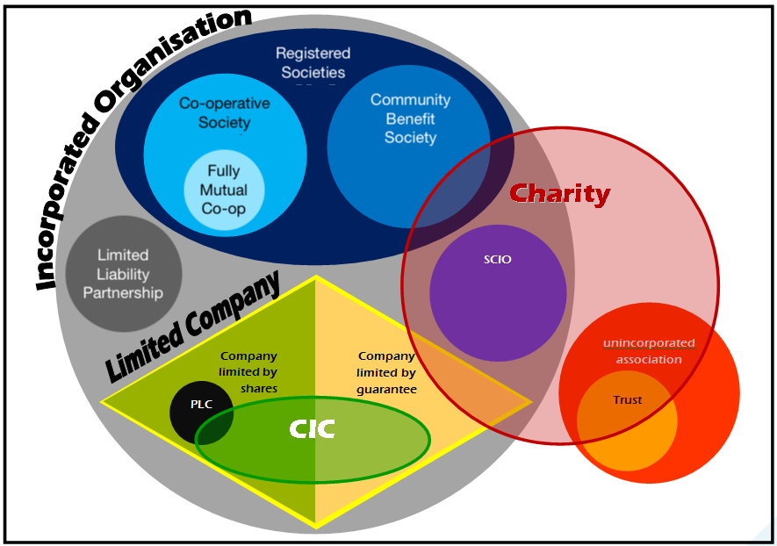
Notes:
Overview of different structures
Important to be incorporated – constitution = protection from liability ‘limited’
Exemptions for registered societies (shares etc)
Charity as separate layer, only possible for some societies
What legal structure do you currently have?
What legal structures might be appropriate for a future community energy project?

Slide 39
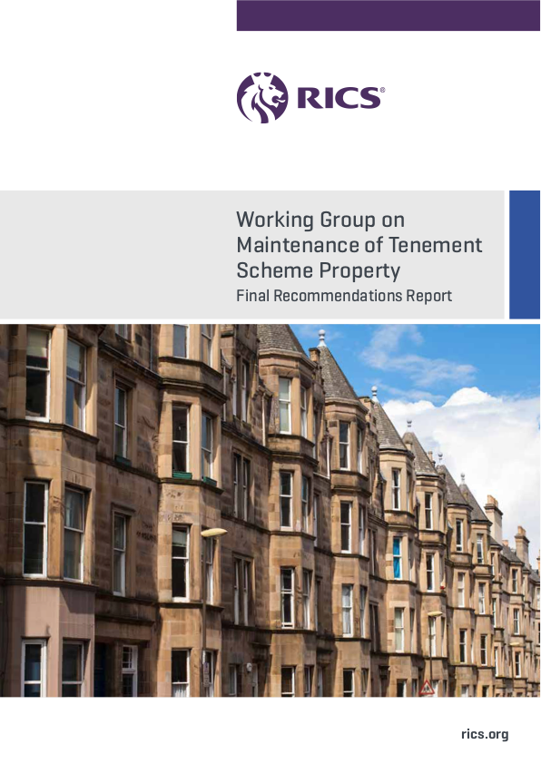
Notes:
Reccommendation for
Mandatory residents assocuiation
Mandatory contribs & accounts
Mandatory decision making mechanism

Slide 40
Co-operatives and Community Benefit Societies
Community Shares Scotland
Notes:
The relevance of registered societies for future community energy projects

Slide 41
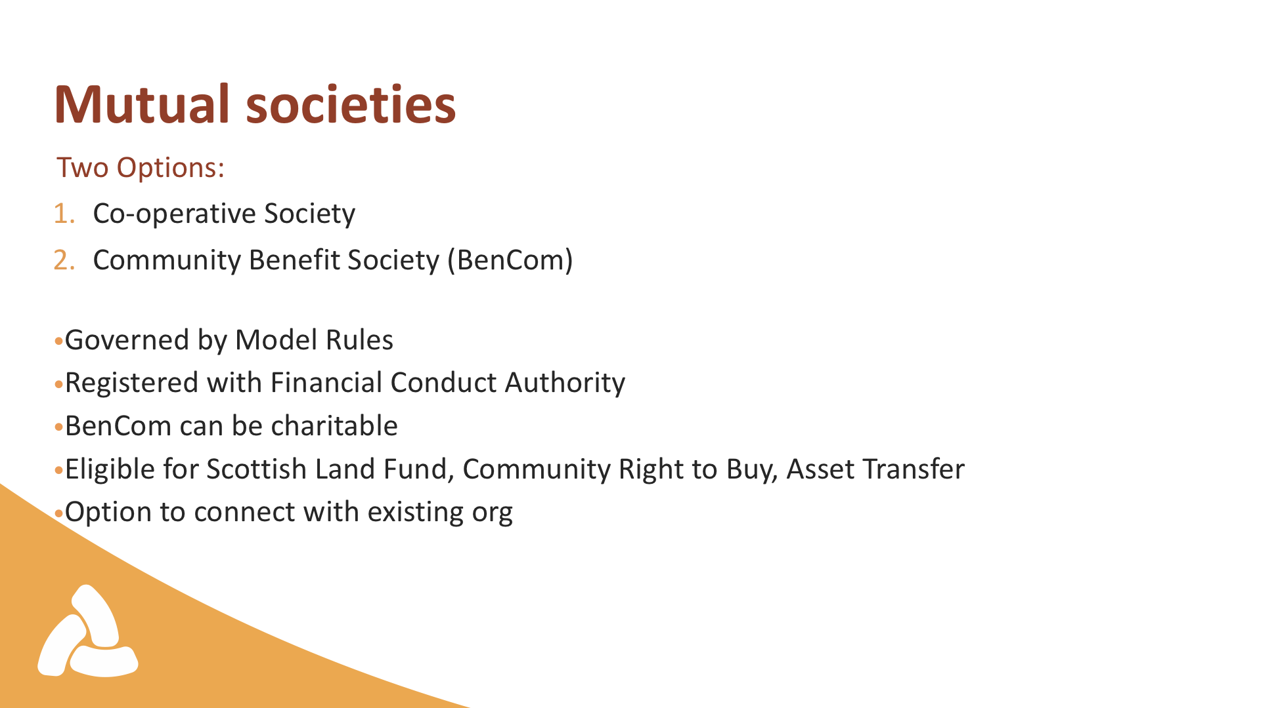

Slide 42
Funding & Financing

Slide 43
Business Models
How things have changed…

Slide 44
Feed-in Tariff
capital
Loan
Power Purchase Agreement
Loan repayments
O&M

Slide 45
Feed-in Tariff
capital
Loan
Power Purchase Agreement
Loan repayments
O&M

Slide 46
capital
grant
Power Purchase Agreement
O&M

Slide 47
capital
Loan
Local Supply
Loan repayments
O&M

Slide 48
other services
capital
Power Purchase Agreement
O&M
Notes:
Other services
Flexibility services
Associated benefits
Local sale

Slide 49
Capital
Grants—CARES?
Donations — crowdfunding
‘Patient capital’ — community shares
Climate Financing — Resource Efficient Scotland? Social Investment Scotland?
Low-cost technologies & sites – reduce capital outlay
Notes:
RES – interest free loans to companies to install energy saving measures
Not possible to combine with RHI, FiT…

Slide 50
Increase income
Improved PPA—HH wholesale price?
Price arbitrage—beware of DUoS
Local supply—regulatory barriers
Reduce curtailments—DSR and ANM
DSO services—location-dependent
National Grid services—through aggregator

Slide 51
Reduce running costs
Low-maintenance systems
Increase self-consumption
Low-interest finance

Slide 52
savings
cost of capital
services
O&M
sales

Slide 53
Current Funding
What grant support is available now?

Slide 54
Community/Local Energy Funds
  Scottish Government (via Local Energy Scotland)
  Community & Renewable Energy Scheme (CARES)
  Enablement grants of <£25,000
  Development loans of <£150,000
  Innovation grants of <£150,000
  Improving Consumer Outcomes Fund
    Up to £12k in stream 1 – feasibility – 3 December deadline
    Stream 2 – demonstration projects – will come after Stream 1

Slide 55
Innovation & Capital Funding
Aim for economic growth via green tech. Funds larger scale project consortiums, normally
including start-up businesses bringing private match funding
Low Carbon Infrastructure Transition Project (LCITP) – UK Gov
  Technology specific calls. ‘Catalyst’, ‘Development’, or ‘Demonstrator’ support
Network Innovation Competition (NIC) – Ofgem ~£70m / year
  Fund to demonstrate innovation for the grid. Only the network operators can bid
Horizon 2020 – European Union
Industrial Strategy Challenge Fund – BEIS
Notes:
LCITP: low carbon and/or renewable electricity and heat generation, local energy economies, heat recovery (e.g. district heating), energy storage and distributed energy systems, hydrogen, demand side management and active network management, energy efficiency (e.g. non-domestic building retrofit)
What they are looking for: an innovative approach to cross sector collaboration to ensure successful project delivery; the potential to deliver significant reductions of greenhouse gas emissions and/or energy consumption; must be match funded; the potential to have a positive and significant social and economic impact on Scotland; community engagement and/or potential for community investment; and the ability to demonstrate directly the added benefits that can be delivered through LCITP support
NIC: deadline for 2019-20 bids just gone, but likely to continue into RIIO 2 in future

Slide 56
Technology Specific Funds
Support for particular technologies. More detail in the relevant
sessions
Transport: Energy Savings Trust / Chargepoint Scotland
  Grants for electric vehicles and support for car clubs
Low Carbon Heat: District heating loan fund
  Loans to help Councils and Housing associations build heat networks

Slide 57
Social Impact & Fuel Poverty Funds
Primary aim of reducing energy bills, empowering and supporting vulnerable
customers. Support for community energy where demonstrable benefit to
vulnerable households
Green Economy Fund
Robertson Trust
Climate Challenge Fund
Energy Redress
Lottery – Community Assets Fund (2019 fund just closed)
Notes:
Green Economy Fund: renewable and low carbon innovative solutions; Transport – promoting the uptake and infrastructure provision of Electric Vehicles or other low carbon solutions; Heat - provision of affordable energy for consumers – addressing fuel poverty; Local energy systems – creation of local energy solutions to match generation and demand; Learnings and data to assess future impact of low carbon economy; Low carbon job creation
What they are looking for: projects addressing fuel poverty and vulnerable customers; energy advice that does not duplicate existing advice services; install energy saving or renewable energy measures that cannot be funded elsewhere; innovation (though not a requirement); high carbon savings, air quality benefits or social impacts; replicability; strong community benefit or wider community benefit

Slide 58
Financing Options
Where to get non-grant money

Slide 59
Co-operatives and Community Benefit Societies
Community Shares Scotland
Notes:
The relevance of registered societies for future community energy projects

Slide 60
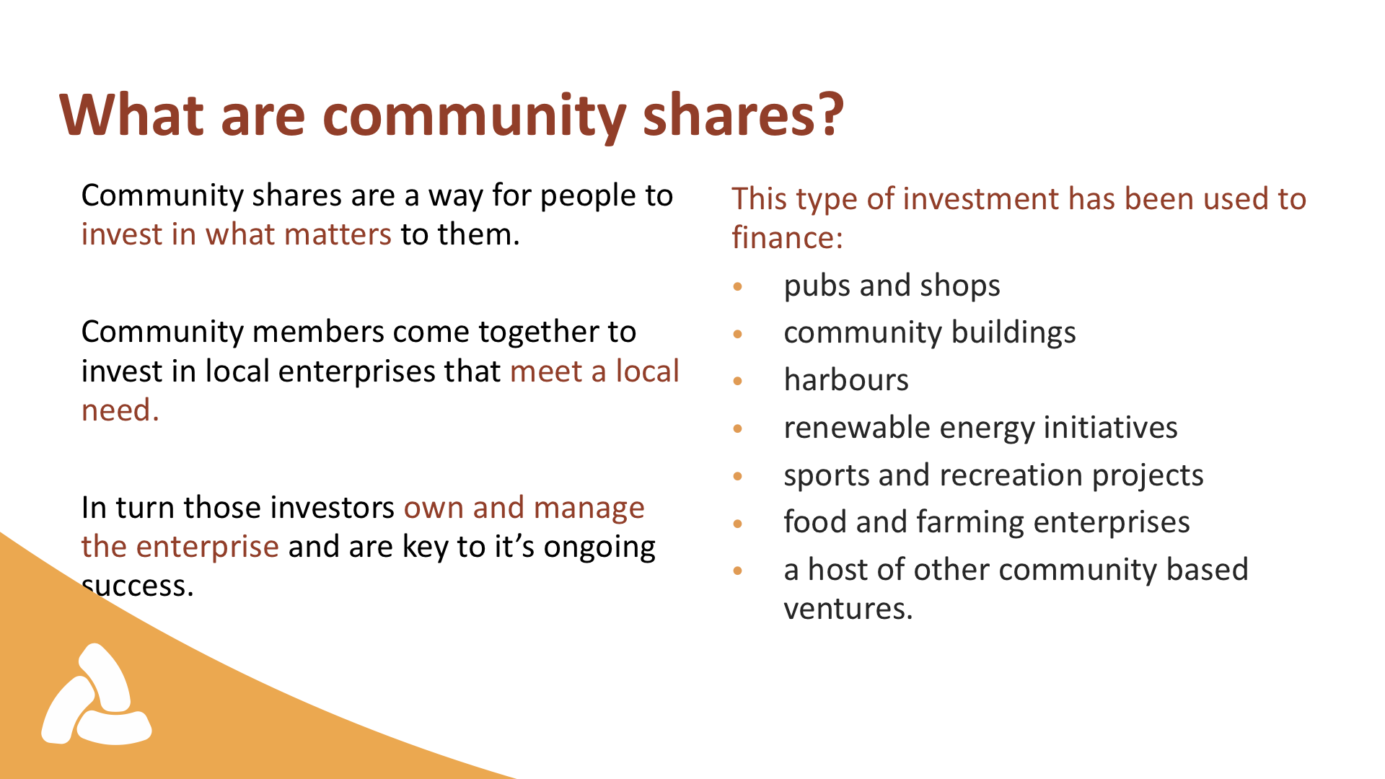

Slide 61
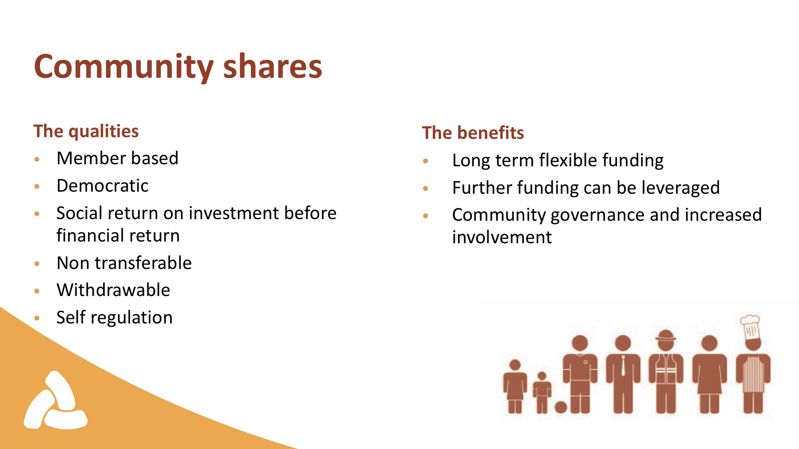

Slide 62
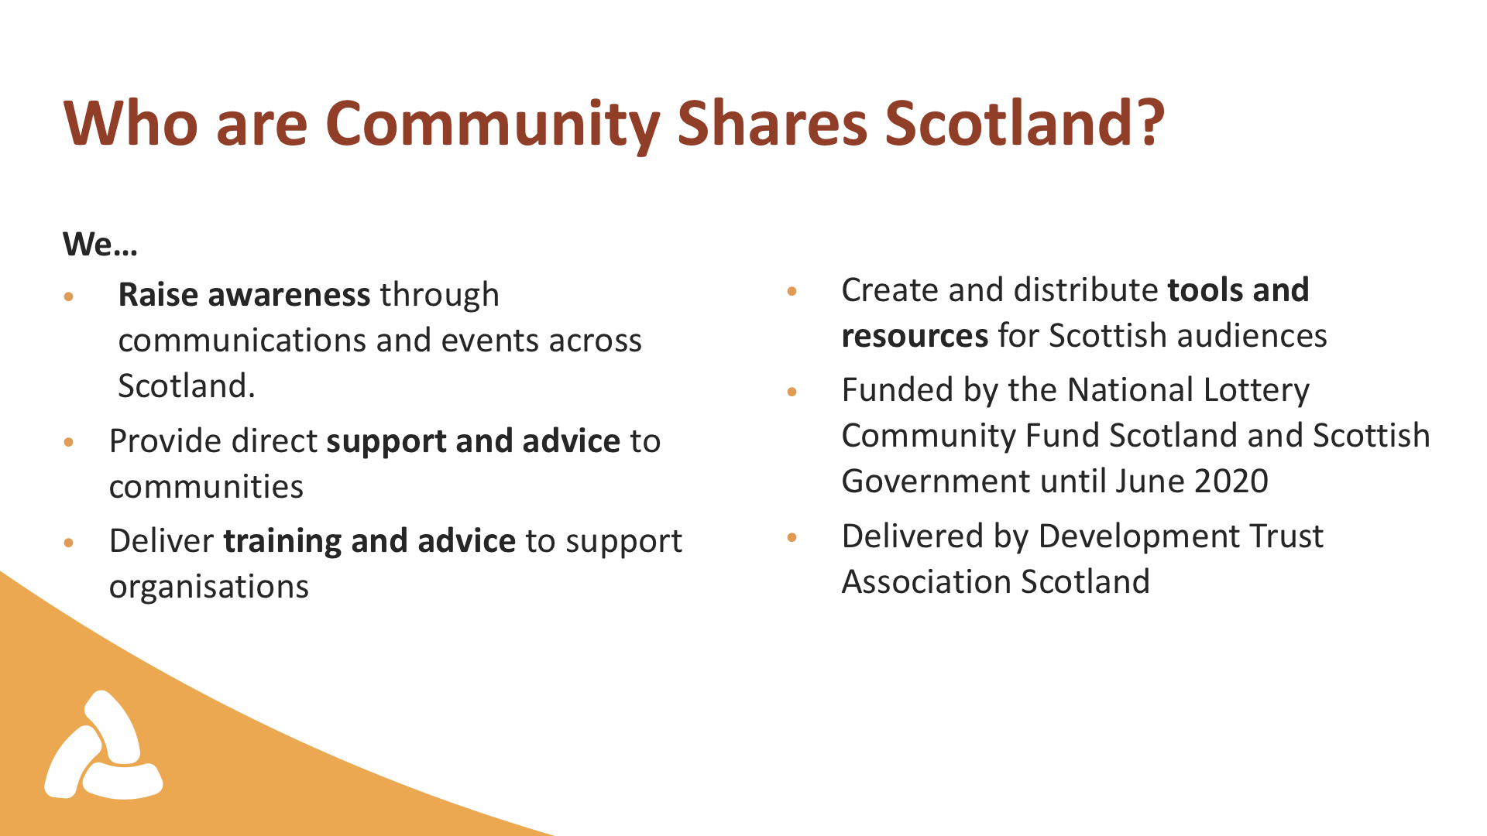

Slide 63
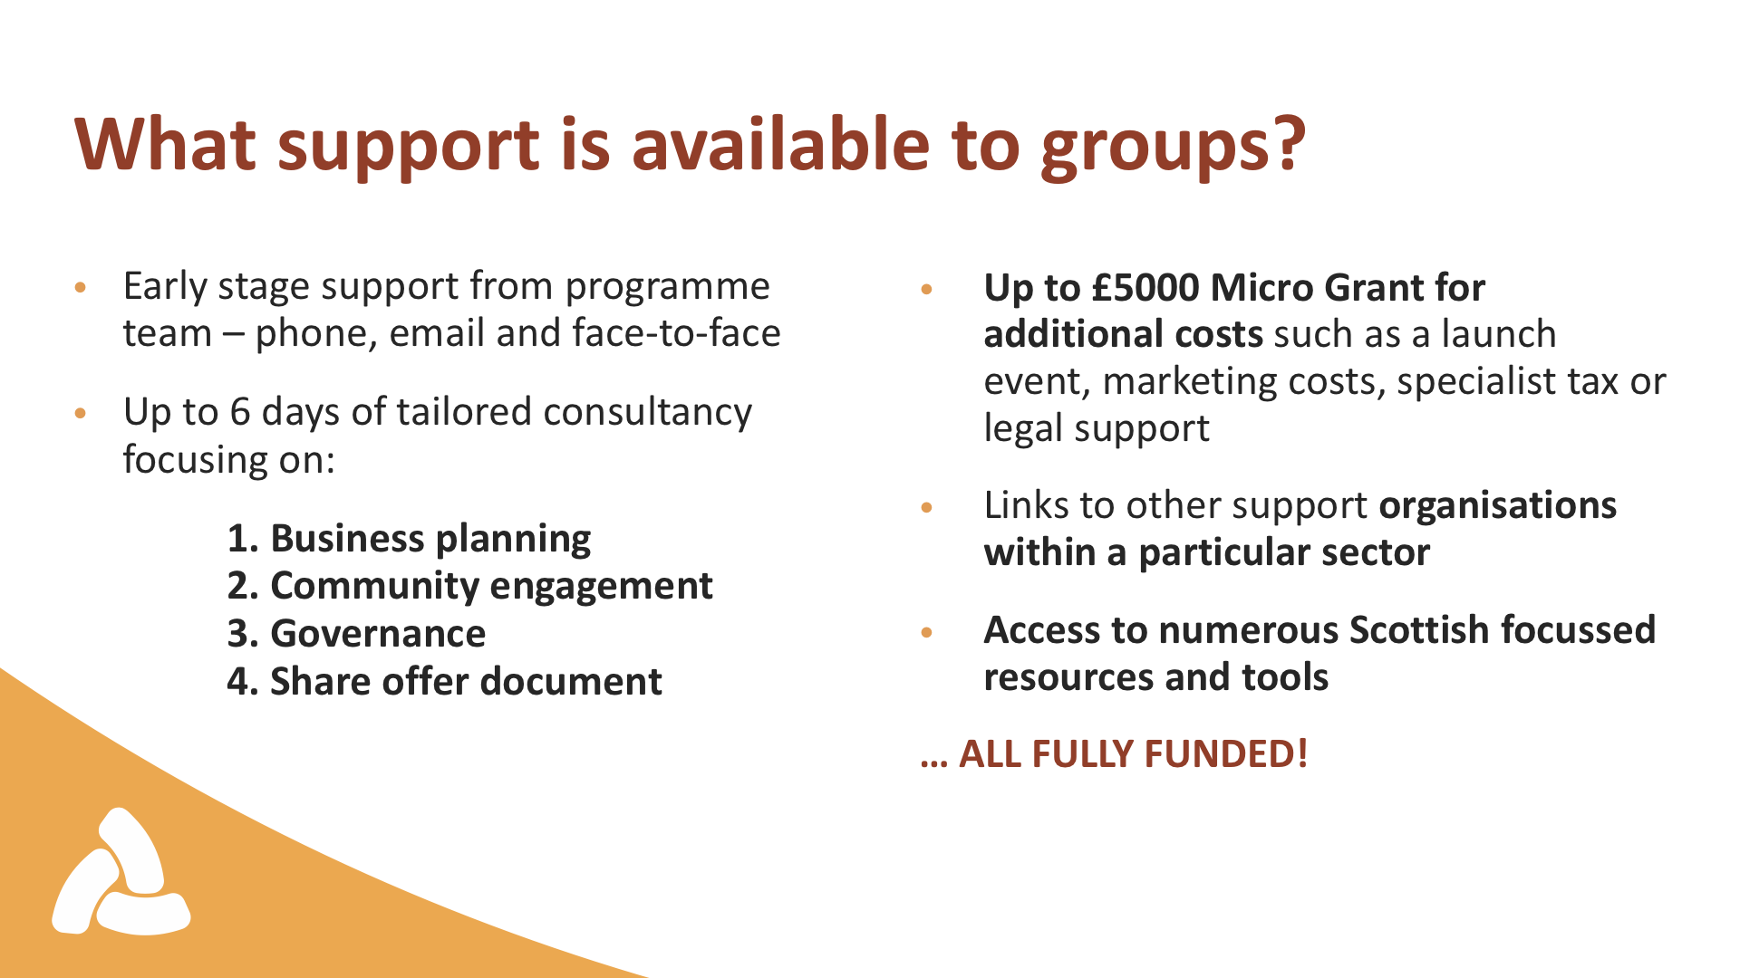

Slide 64
  Other possibilities
Share offer platforms
Ethex
Abundance investments
Climate / Social Investors
Energy Investment Fund
Social Investment Scotland
Impact Investing Institute
Investment incentives
Tax relief schemes—SITR, CITR, EIS, SEIS
Notes:
SITR/CITR only if you can demonstrate social outcomes
EIS & SIES explicitly withdrawn due to FiT, but now may be possible again??

Slide 65
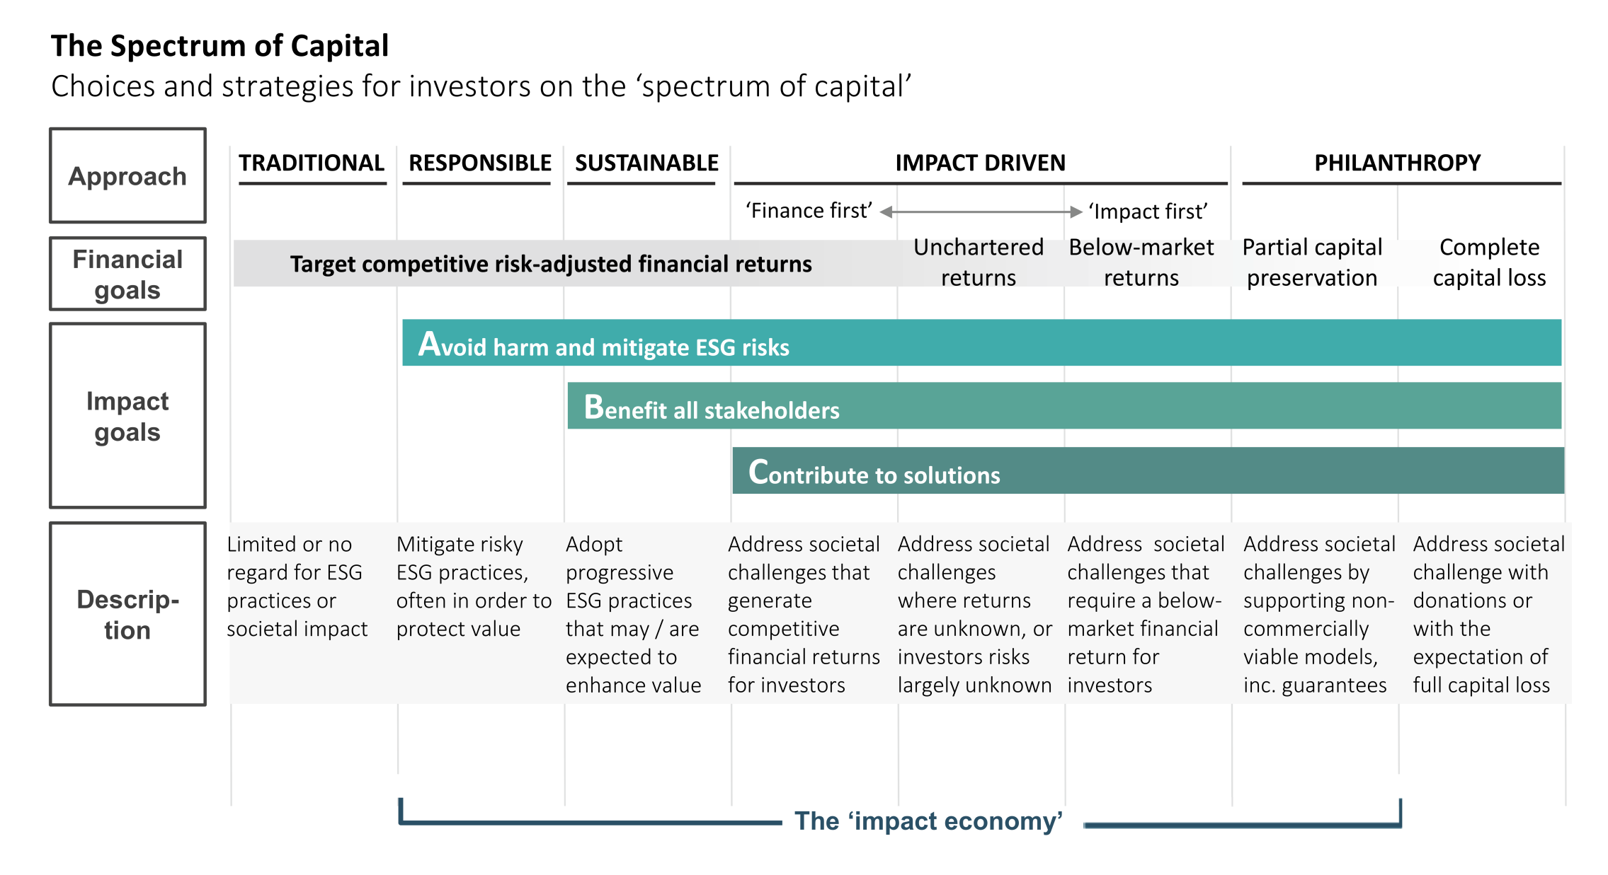
Impact Investing Institute

Slide 66
Workshop Sessions: 2019 - 2020
Community energy futures
Low carbon transport
Making it happen
Smart homes and buildings
Low Carbon Heat
Smart networks
  Introduction to the course
  One-to-one support
  Our changing energy system
  Electric and hydrogen vehicles
  Community vehicles and shared travel
  EV charging projects
  Community engagement
  Local energy planning
  Partnerships
  Funding & financing
  Smart meters
  Smart controls and appliances
  Flexing domestic demand
  Heat policy
  Energy efficiency
  Heat networks
  Smart electric Heating
  Grid constraints
  Active Network Management
  Local energy systems
  What next?
10 October
7 November
5 December
9 January
6 February
5 March
Individual Support
Finding Out Your Needs,
Tailoring the Sessions
Consultation Event, Research & Developing Ideas
Funding Options & Where Next….

Slide 67


Community Energy Scotland
Empowering Communities, Improving Lives
Visit our Community Energy Futures webpage at:
www.communityenergyscotland.org.uk/community-energy-futures.asp
Follow us on Twitter @CES_Tweet
Follow us on Facebook @communityenergyscotland

