Slide 1
Low Carbon Heat
http://www.communityenergyscotland.co.uk
Scottish Charity Number:SC039673

Slide 2
Aims
Set the scene on the policy environment around heat decarbonisation and discuss the ways communities can engage with low carbon heat and energy efficiency measures
Explore the types of sustainable heating technologies and discuss the benefits and drawbacks of heat networks as a method of distribution.
Consider the role that electric networks can play in low carbon heat particularly with respect to ‘smart’ electric heating.

Slide 3
Heat Policy & Decarbonisation

Slide 4
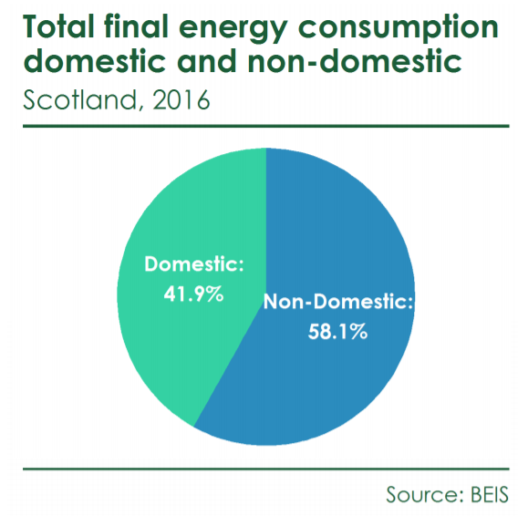
How much energy do we use for heat?
In Scotland, heat makes up more than half of the total energy used

Slide 5
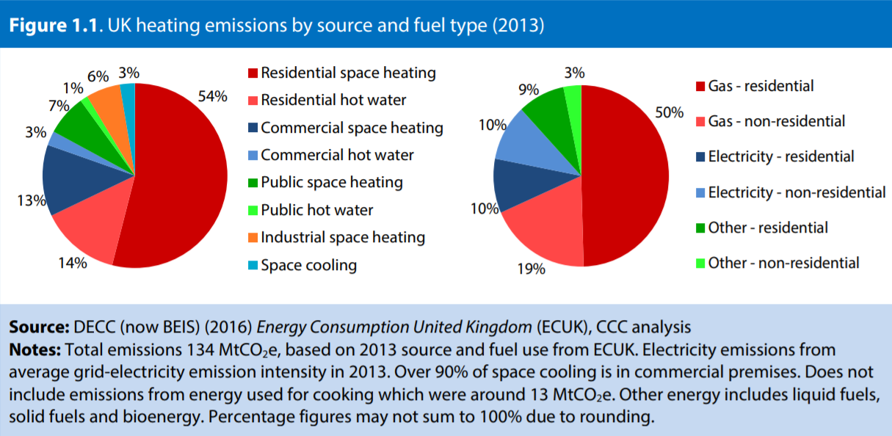
How do we keep our buildings warm?
Natural gas is the main source of heat for both domestic and commercial use across the UK.
Gas fuels 78% of Scottish households’ primary heating systems

Slide 6
Burning fossil fuels impacts….
Carbon Emissions
Air
Pollution
Energy Security
Climate Change
Public Health
Notes:
Energy security: oil & gas not an infinite resource. As the amount of gas that can be extracted from the North Sea declines, we’ll need to import more to ensure a regular and reliable supply
to the UK.
UK currently produces 44% of gas needs from the North Sea and the East Irish Sea.
We import 47% of the gas we use via pipelines from Europe and Norway.
The remaining 9% comes in to the UK by tankers in the form of Liquefied Natural Gas (LNG).

Slide 7
Why switch to renewable heat?
In Scotland, heat is the largest single source of our carbon emissions (47%)
Climate Change (Emissions Reduction Targets) (Scotland) Act 2019
Reduce emissions of greenhouse gases by:
56% by 2020
75% by 2030
90% by 2040
Net zero emissions by 2045

Slide 8
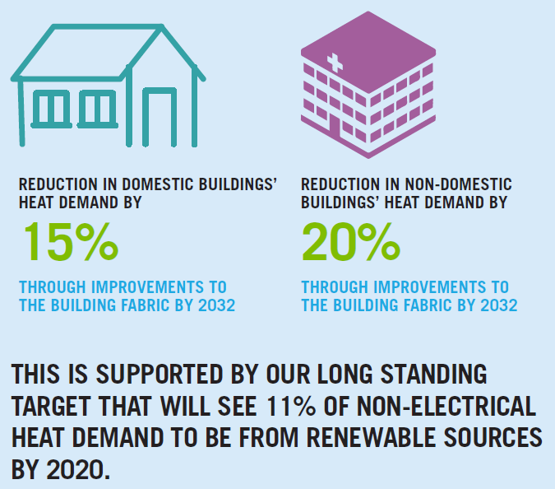
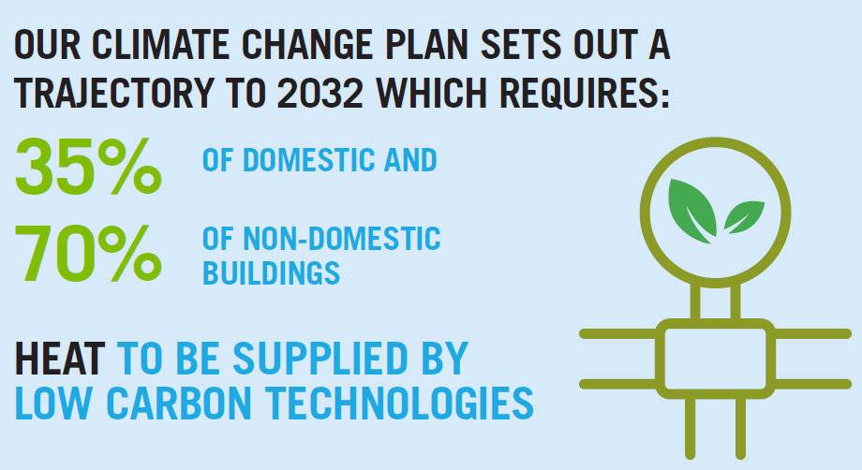
Scottish Govt. Heat Emission Reduction Targets
Images from Scottish Government’s Energy Efficient Scotland: route map

Slide 9
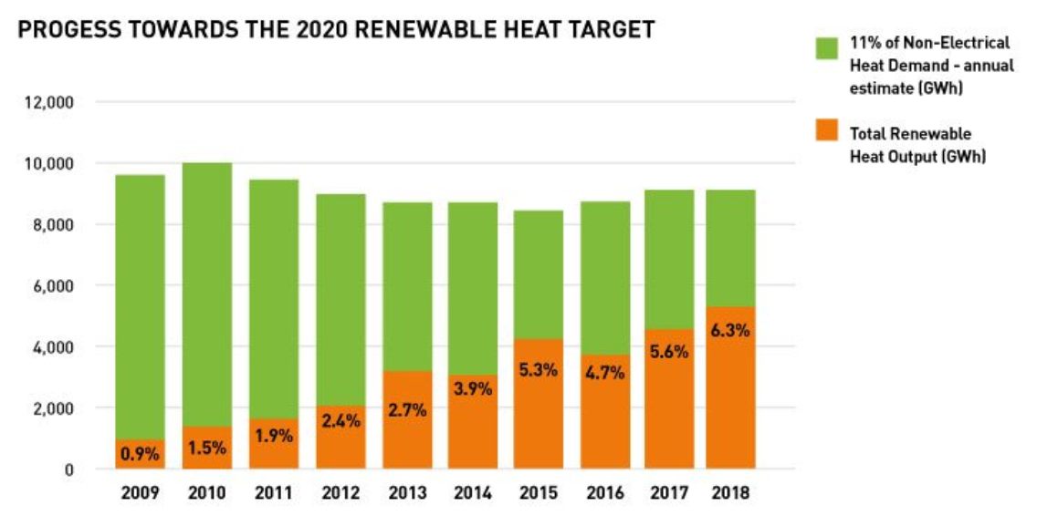
How is Scotland currently performing?
Security
Energy Trilemma
Affordability
Sustainability
Image from Scottish Renewables
Notes:
Affordability is a key factor which is stopping people adopting low carbon heat techs
Gas is between 3-4 times cheaper than electricity in the UK per kWh

Slide 10
What are our options?
In their Scottish Energy Strategy, the Scottish Government have
identified three possible pathways for renewable heat:
Electrification
Heat pumps will provide the majority of domestic demand and the industrial sector will rely on a mix of fuels, including electricity, bioenergy and natural gas¹
Gas network decarbonisation (Hydrogen)
Will replace natural gas for most industrial and commercial heat demand. Areas without access to hydrogen or low carbon gas will convert from direct heating to heat pumps, or will be supplied via heat networks where this is feasible
Mixture of both
Notes:
To meet the specific requirements of high temperature processes, or those that require specific chemical reactions which cannot be provided solely by electricity.
NOTE: heat regulation is devolved to the Scottish Parliament but issues which affect the heat market, such as the gas network, electricity and oil, are reserved. So, the longer-term approach to decarbonising heat will depend on UK Government decisions on the future of the gas network. UK Government should make these decisions by the early 2020s.

Slide 11
Funding & Financing
Renewable Heat Incentive (RHI Domestic & Non-domestic):
Financial incentive scheme to encourage uptake of renewable heating
Scheme participants receive quarterly payments for seven years for the amount of clean, green renewable heat their system produces
Ends 31st March 2021
Notes:
Not clear if this will be replaced but indications from Scottish Government suggest more of a stick than carrot approach moving forward.

Slide 12
Funding & Financing
Home Energy Scotland Loan Scheme:
Open to homeowners
Interest-free loan up to £38,500 for energy efficiency measures, renewable technologies, energy storage systems and connections to an approved district heating scheme powered by a renewable energy source
SME Loan Scheme:
Interest free loans to organisations up to £100,000 for the installation of efficiency measures and renewable technologies via Resource Efficient Scotland (RES).

Slide 13
Funding & Financing
District Heating Loan Fund:
£30 million fund - part of wider Low Carbon Infrastructure Transition Programme
Financial support will account for 50% of the total eligible costs of a capital project – including those focused on reducing emissions – up to a maximum of £10 million.
Loans of up to £1M + are available as low interest unsecured loans with repayment terms of either 10 or 15 years.
Open to local authorities, registered social landlords, SMEs and energy services companies with less than 250 employees.

Slide 14
What is a green heater?
Notes:
Full group discussion: What green heating types are people aware of?
Cover: storage heaters, heat pumps, biomass, hydrogen
For each: describe it, why green, best locations, problems
Summarise on flipchart, then flick through slides covering any remaining points/techs missed

Slide 15
Heat pumps
May be air-, ground- or water-source (ponds, rivers, sea)
Typical coefficient of performance of 2.5-4; very efficient
Long lifespan, especially GSHPs, and low maintenance
Higher capital cost than an oil/LPG boiler
May stack up against oil/LPG, and definitely direct electric, not gas
Will increase overall electrical demand; not strictly renewable unless powered from 100% renewable tariff
Needs wet heating distribution; may require upgrades to radiators

Slide 16
Notes:
https://commons.wikimedia.org/wiki/File:Pond_Loop_Being_Sunk.jpg Marktj grants anyone the right to use this work for any purpose, without any conditions, unless such conditions are required by law.

Slide 17
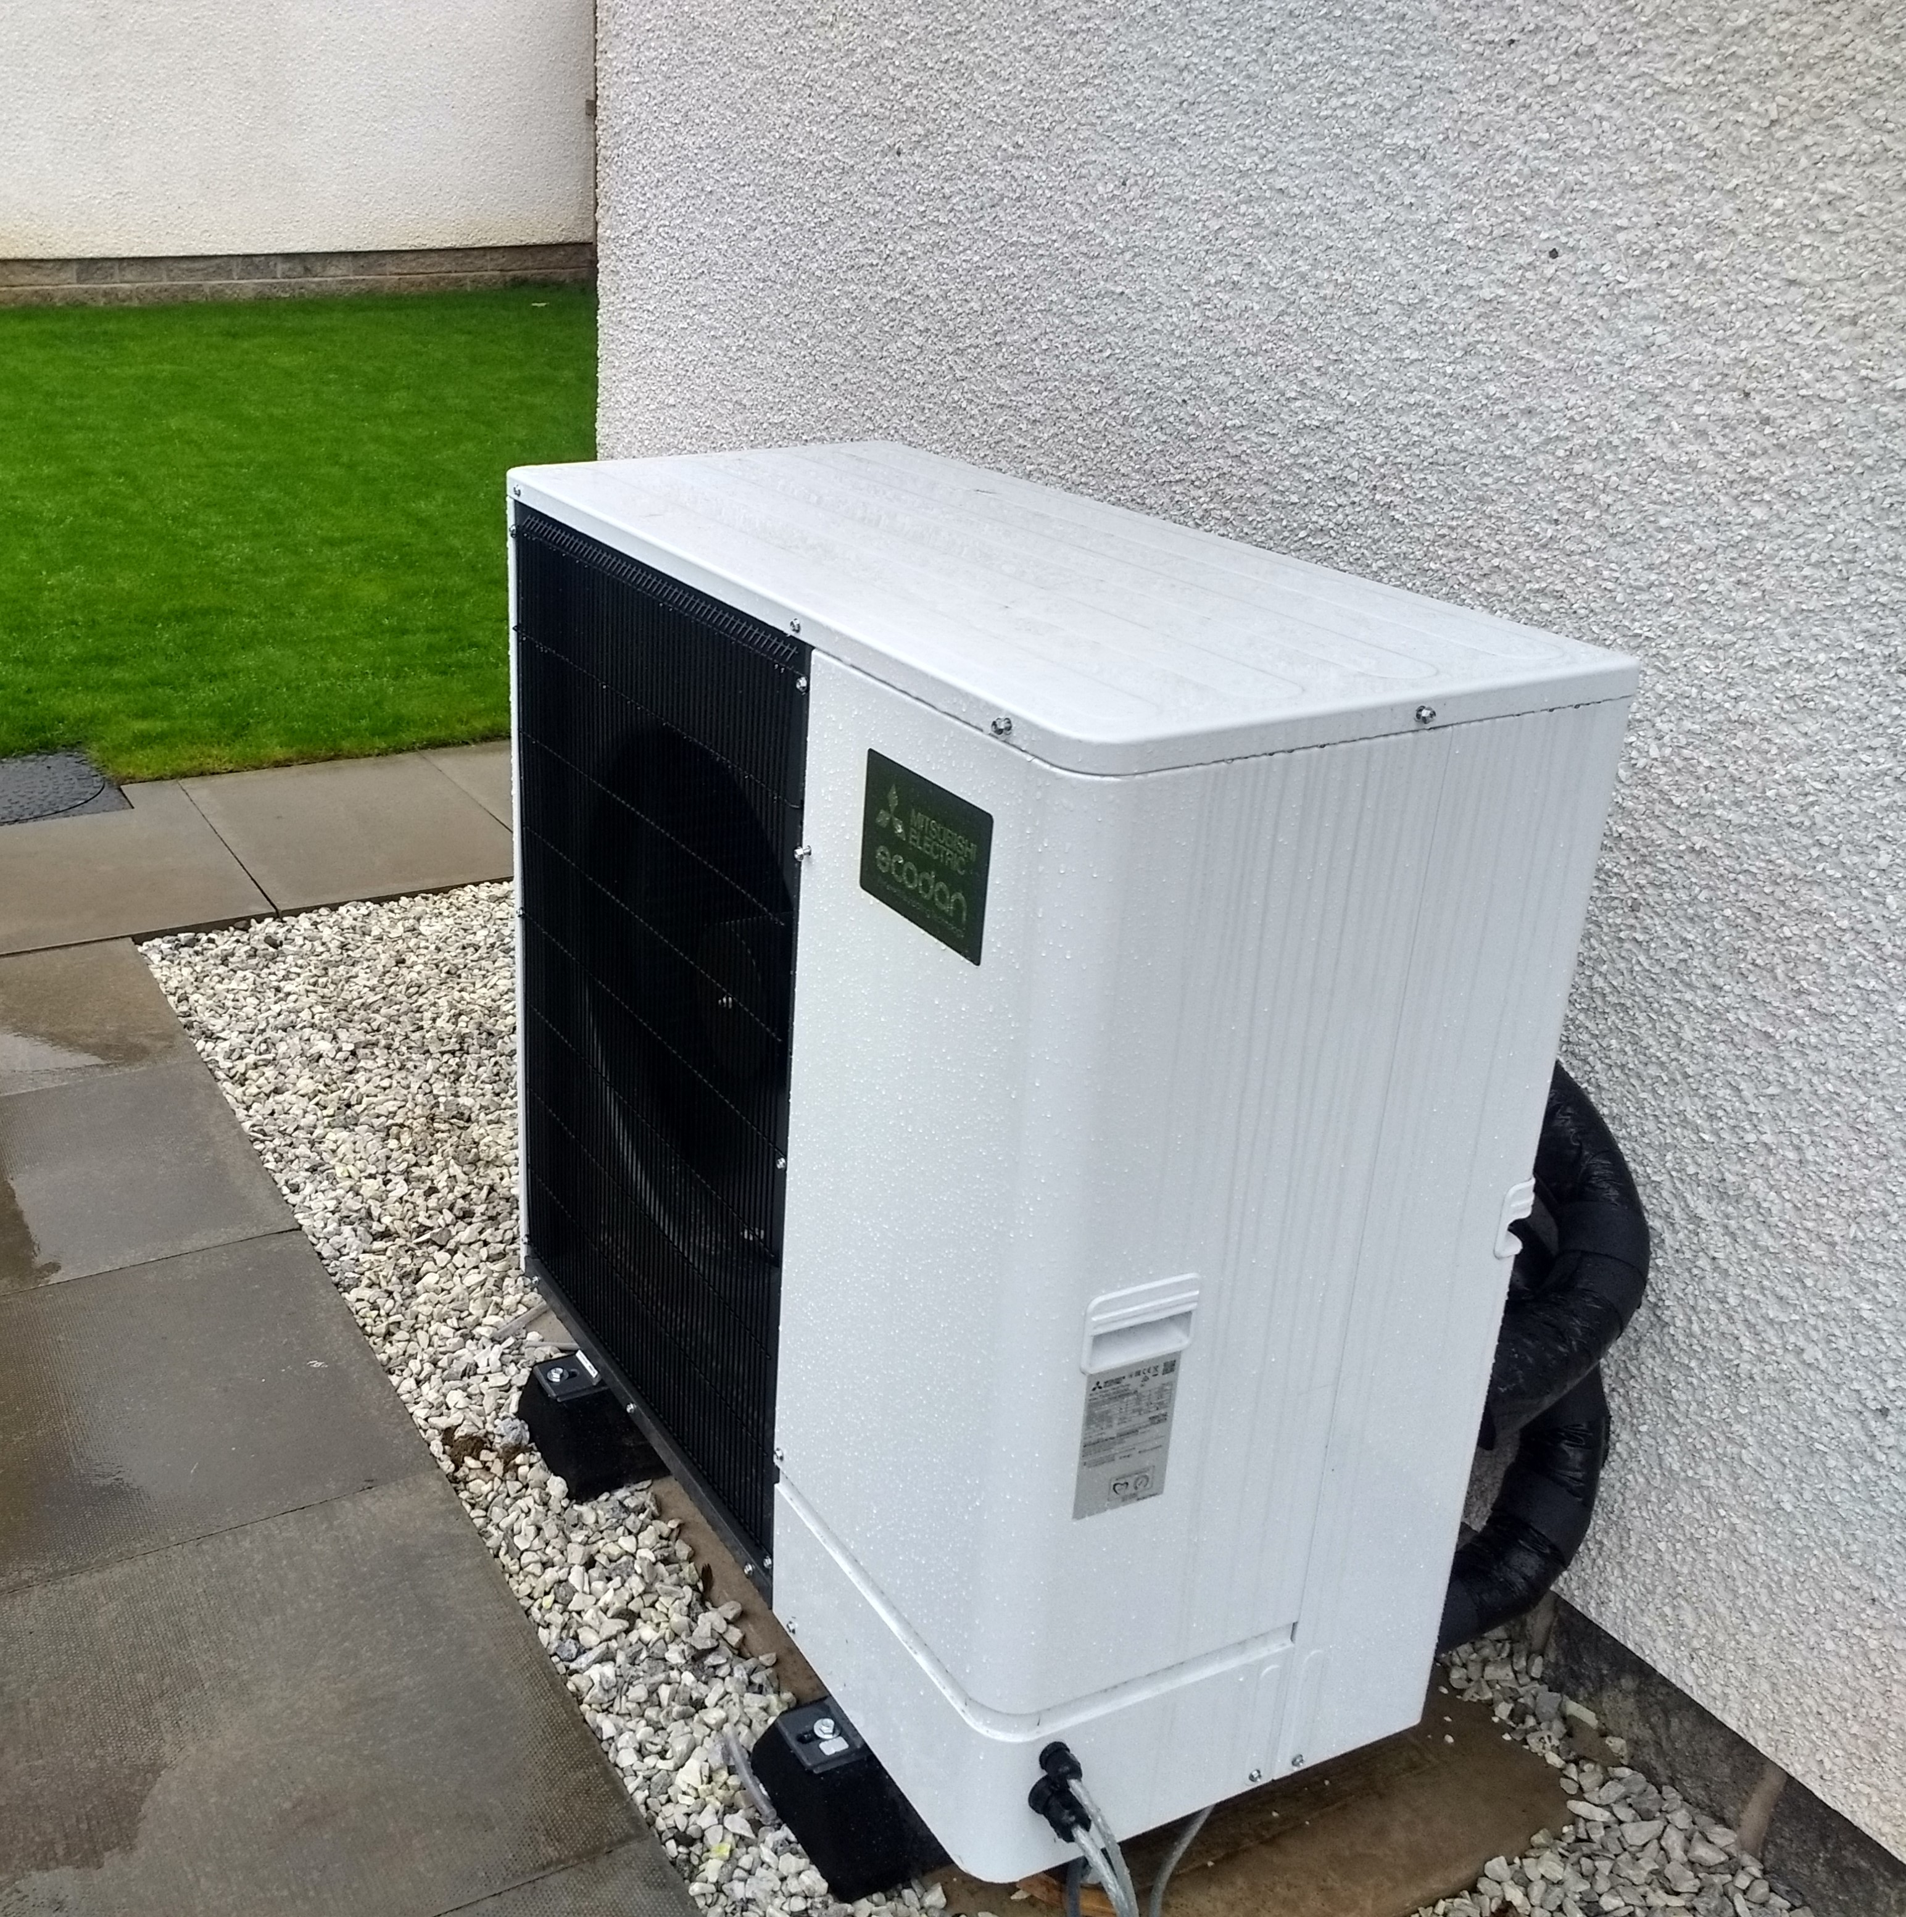
Notes:
CES photo - ASHP

Slide 18
Biomass
May be log stove or boiler, pellet or woodchip
Woodchip good for larger buildings; more infrastructure required
Log systems can be very cheap with on-site timber, but lots of work
Pellets are easiest to use (much like oil), but most expensive per kWh
Supply improving but variable, especially in remote areas
Will stack up economically against oil/LPG/electric, but not gas
Similar lifespan to oil boiler; more mechanical parts
Green credentials depend very much on source and drying method

Slide 19
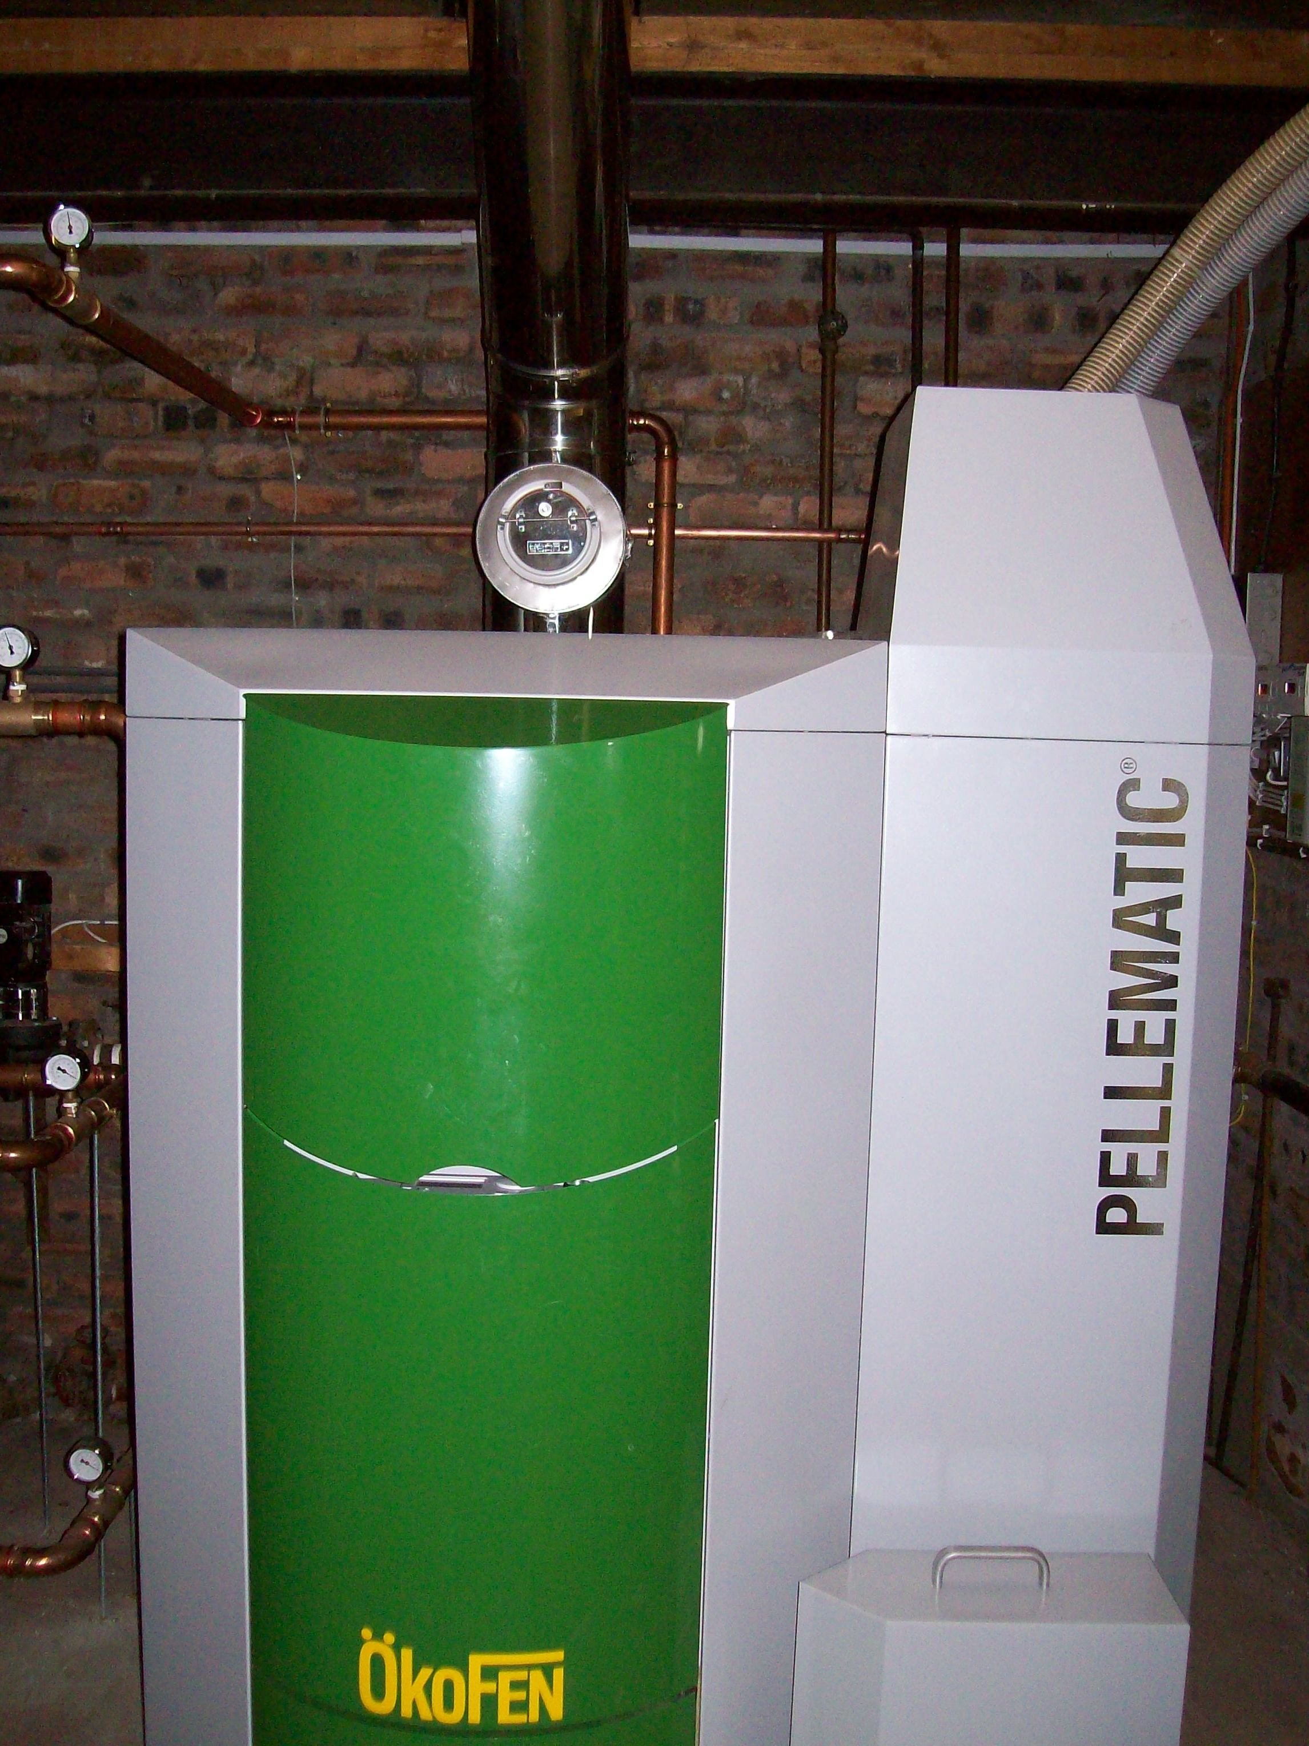
Notes:
CES photo – pellet boiler

Slide 20
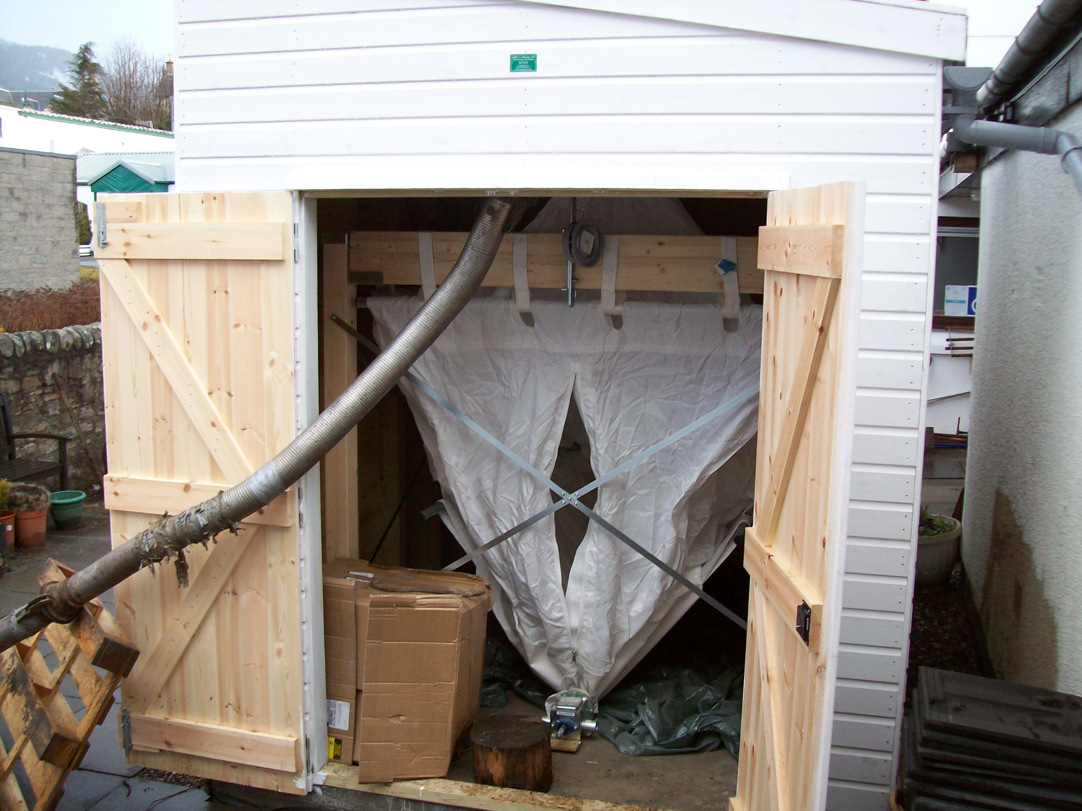
Notes:
CES photo – pellet store (prior to filling)

Slide 21
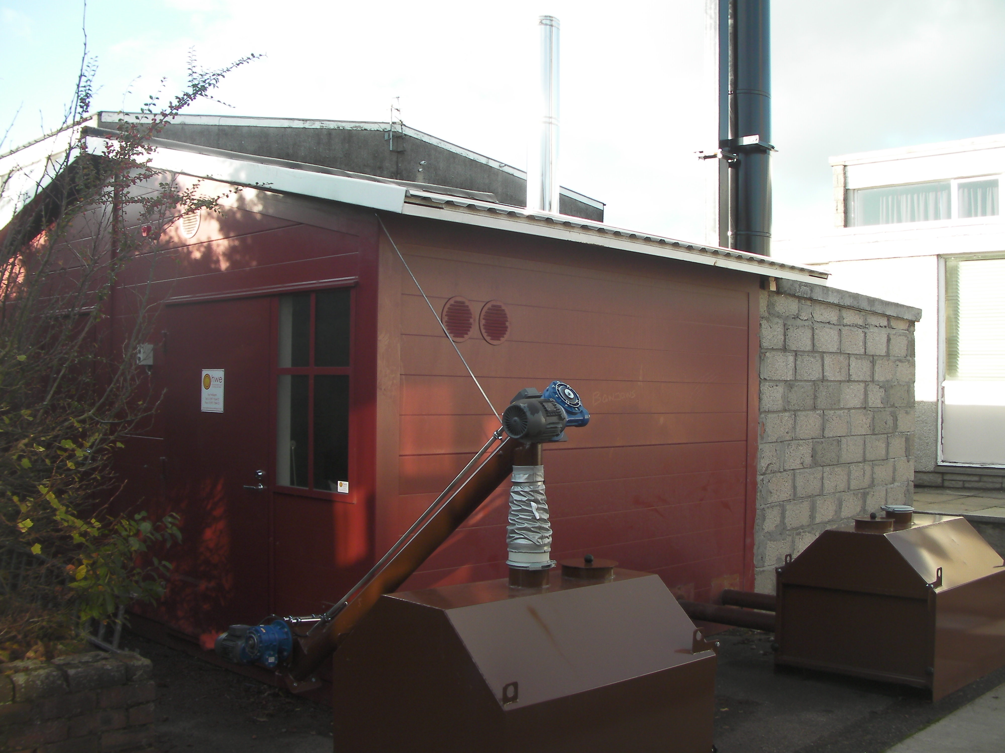
Notes:
CES photo – containerised wood chip boiler and fuel store

Slide 22
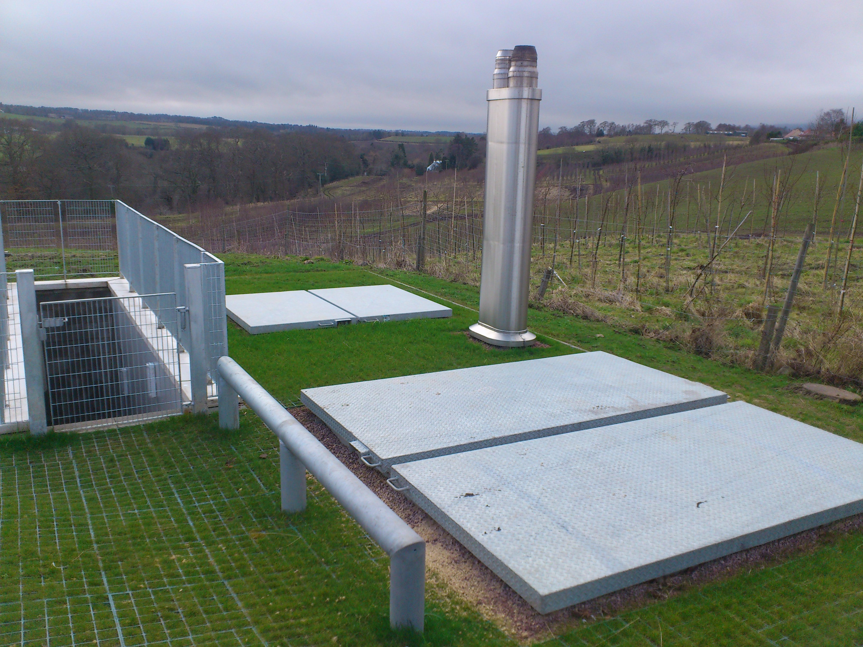
Notes:
CES photo – underground biomass boiler and fuel store (Rosslyn Chapel)

Slide 23
Direct electric heating
May be electric flow boilers, panel heaters or storage heaters
Storage heaters most common and cheapest capital cost overall
Don’t have a good reputation in terms of running cost or comfort
Can be considered a green heater if supplied from renewable tariff
Lots of scope for flexibility and storage as discussed in last session
Could be installed almost anywhere, but more expensive than gas
May well play an increasingly important role in decarbonizing heat
Consumers will need financial incentives and more controllable tech

Slide 24
Hydrogen boilers
Existing gas grid/boilers could in theory be retrofitted to use hydrogen
Very little uptake to date (some limited hydrogen injection)
CCC believes volumes required would have to come from reforming natural gas with carbon capture and storage (itself undeveloped)
Producing in bulk using electrolysis from renewable electricity would be prohibitively inefficient and expensive
CCC have recommended roll-out despite these challenges, given the relatively low capital costs and widespread replicability – but the running costs (especially with CCS) remain unproven
Notes:
https://www.theguardian.com/environment/2018/nov/22/uk-hydrogen-heating-2050-emissions-targets-gas-boilers-electric-climate-change
https://assets.publishing.service.gov.uk/government/uploads/system/uploads/attachment_data/file/760508/hydrogen-logistics.pdf
https://www.theengineer.co.uk/converting-the-gas-network-to-hydrogen/

Slide 25
Solar thermal
Flat plate and evacuated tube versions available
Relatively inexpensive, but still low uptake
Long payback period against cost of gas
Will only provide hot water (mainly in summer); not much heating
Still worth doing and should be mandatory for all new-builds
Part of the solution but not the complete answer for any building

Slide 26
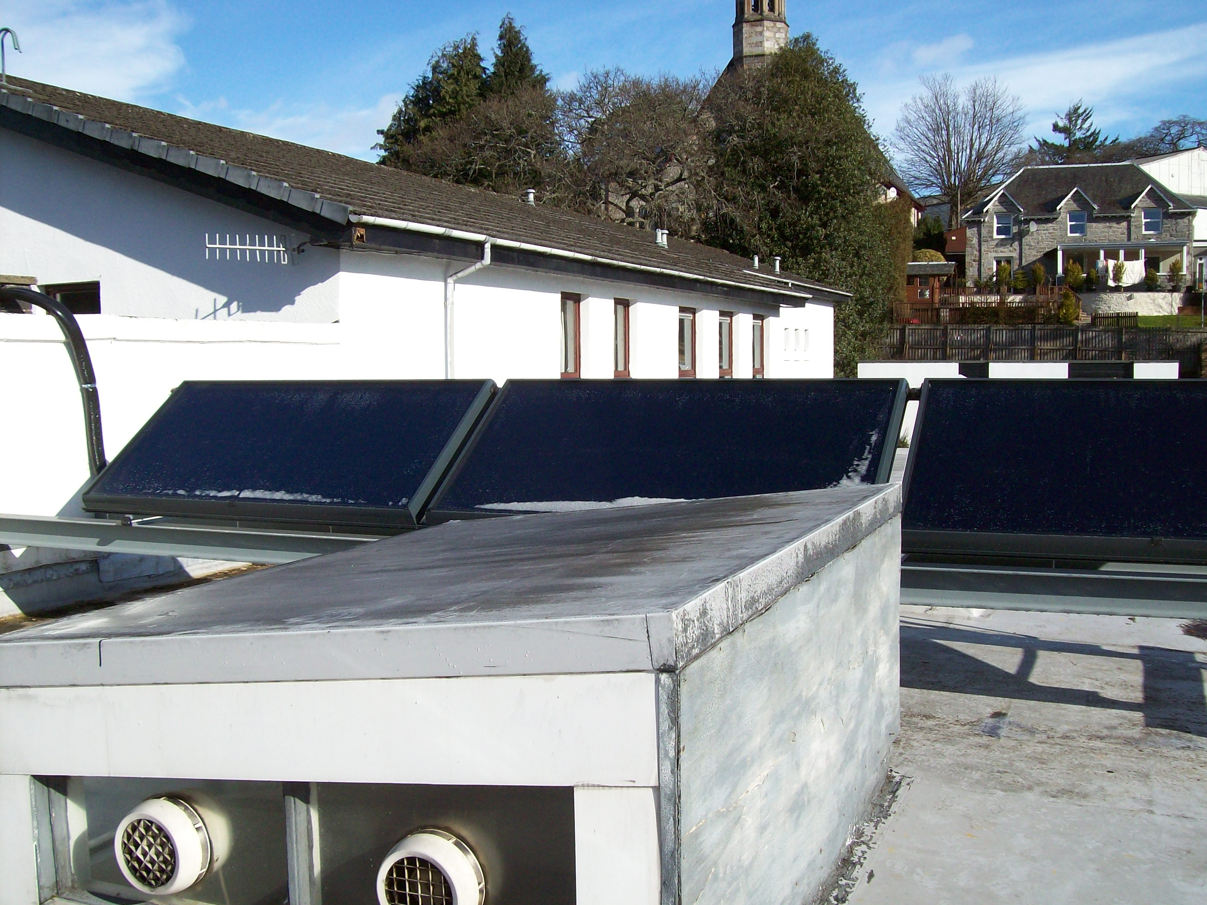
Notes:
CES photo – flat plate solar thermal

Slide 27
Community action on heat

Slide 28
Government Priorities for Action
Local government to take more of a leading role, raising confidence and awareness, as well as backing financial support to facilitate low carbon heat
Long term funding mechanisms and subsidies for low carbon tech, to provide security and encourage investment/innovation to decrease costs in the longer term.
Carbon taxation as a key policy tool to encourage the growth of low carbon energy markets
Bans on certain fossil fuel heating systems
Exploit synergies with local natural resources – make use of forestry, agriculture, waste, solar and wind resources to reduce dependence on fossil fuels for heat
VAT reduction on energy efficiency improvements in homes
Regulation of district heating

Slide 29
Obstacles
Lack of consumer and supply-chain knowledge of low carbon heat technologies
High capital costs of installing low carbon heating systems
Lack of regulatory requirement to install low carbon heating systems;
LCH technologies not suitable for some energy intensive industrial processes
Lack of grid capacity in certain areas limits increases in electrically powered techs
Mixed ownership buildings e.g. flats

Slide 30
Community-led energy efficiency

Slide 31
Energy efficiency is key…
New Build
Energy efficiency & low carbon heat systems
Existing buildings off the gas grid
Options: Heat pumps and biomass boilers
Low Carbon Heat Networks in high heat density areas
Energy efficiency in existing buildings
Existing buildings on the gas grid
Key choice for on-gas properties in lower heat-density areas
Biomethane to gas grid
Electrification
or
Hydrogen
or
Mixture of Both
?
Adapted from Committee on Climate Change, Next steps for UK heat policy (2016)

Slide 32
Energy Efficiency Measures
Draught proofing & insulation
Heating system upgrade - newer, more efficient model
Fit better, smarter controls to make existing systems more efficient
Avoid over-heating spaces that do not need to be heated or are used infrequently
Water efficient shower heads

Slide 33
Challenges to energy efficiency
Cost
Hard to treat building stock e.g. older/listed buildings
Retrofits may involve significant disruption e.g. overhauling heating systems, intelligent monitoring systems, insulation and windows.

Slide 34
Community-led heat networks

Slide 35
Heat Networks Bill (2020)
Scottish Government bill currently in consultation
Aims to substantially grow the number of heat networks in Scotland by:
Attracting greater private investment in the sector
Introducing a regulatory framework
Raising public awareness and acceptance
Notes:
Measures being considered:
Regulatory Framework: - introduction of a Scottish Regulator
- licensing system to support developers
- LHEES to be made a statutory duty (most LAs voluntarily participating)
De-risking Investment: - heat network developers to be able to compete to be awarded exclusivity within identified heat network zones
- compulsory connections for large anchor load non-domestic buildings within identified heat network zones
- subsidy (to help compete against gas heating) for low-carbon inputs
Consumer Protections: - publication of tariffs (including standing charges) and benchmarking

Slide 36
What is a heat network?
A network of insulated pipework heating multiple buildings from a centralised source (could be gas, heat pumps, biomass, waste heat)
Electric (non-wet) networks considered in next section
Used very commonly on the continent, especially from process heat
Limited uptake in UK (Southampton geothermal, Aberdeen CHP etc)
Hot water is pumped through the network and passed through heat interface units (HIUs) to pass heat into individual building circuits
May include Combined Heat and Power (CHP) to generate electricity as well (either exported or on-site/private wire supply)
Notes:
https://www.engie.co.uk/energy/district-energy/southampton/
https://www.aberdeenheatandpower.co.uk/

Slide 37
Why are heat networks sustainable?
Not all will use renewable sources (sometimes a mix, or purely gas)
Can be cheaper alternative to storage heating (and safer alternative than gas) in high-rise flats
More sustainable than gas where utilising waste process heat
Potentially more efficient when utilising CHP (no transmission losses)
Advantageous and green when utilising renewable heat sources, which wouldn’t be possible to integrate directly into homes

Slide 38
What are the main challenges?
Extremely complex to retrofit (major civil works around existing utilities, complex legal agreements with users being supplied)
More common in new-build developments, social housing
Users may be resistant as it leaves them with a monopoly supplier
May well be more expensive to build than distributed systems
Disruption during construction in retrofit situations
High cost/metre of insulated pipework; scope for leaks/losses

Slide 39
Where might a heat network be suitable?
New-build housing developments, whilst other utilities are being laid
Situations where demand ownership is unlikely to change (RSLs)
A small number of large users located near to a source of waste heat
Homes located near a good renewable source of heat (mineshaft?)
Potentially high-rise buildings, especially those already served by a wet heat network, potentially swapping from gas to heat pumps

Slide 40
Electric Networks & Heat

Slide 41
What is electric district heat?
DHN Energy Centre
District Heat Networks are a means of distributing heat and can be used with many different types of heat source including electricity
Electric district heating systems involve the use of a central electric boiler as the heat source and the DHN pipework as the method of distribution
Electricity Cables
DHN Pipes
Hydro/Turbine
Notes:
Electric boiler driven DHNs not common – why? Primarily cost – a DHN will generally compare unfavourably with PWN distribution
1. High-temperature DHN insulated pipework & energy centre very expensive
2. If considering electric district heat – you’re almost certain to be off the gas grid. Good chance that buildings will already have electric heating systems (boilers or direct) installed.

Slide 42
How can electric networks enable low carbon heat?
Electric networks do not distribute heat…they distribute electricity which can then be used at the point of demand to generate heat
Electric networks make sense where DHNs are not the most suitable distribution method
Electricity Cables
May or may not be connected to the grid
Hydro/Turbine
Notes:
Electrical private wire network:
Local network which uses distributed energy resources and manages local energy supply and demand
Provides a direct electrical connection between generator and consumer – cuts out middleman, avoids network charges = reduced energy costs for consumers
No central energy centre

Slide 43
Where is an electric network best suited?
Available excess renewable electricity due to limited grid capacity
Areas where energy generation is close to the point of demand
Excess generation is more or less adequate to meet heat demand with or without thermal storage
Areas with high cost of existing heat sources – likely to be off the gas grid
Smaller geographic areas – less wiring keeps costs down

Slide 44
Case Study: Applecross Community Hydro
Feasibility study (2014)
Grid constraints on hydro system limiting export
Excess generation well matched with local heat demand
Assessed ‘wet’ DH option using either WSHP or electrical boiler
PWN recommended

Slide 45
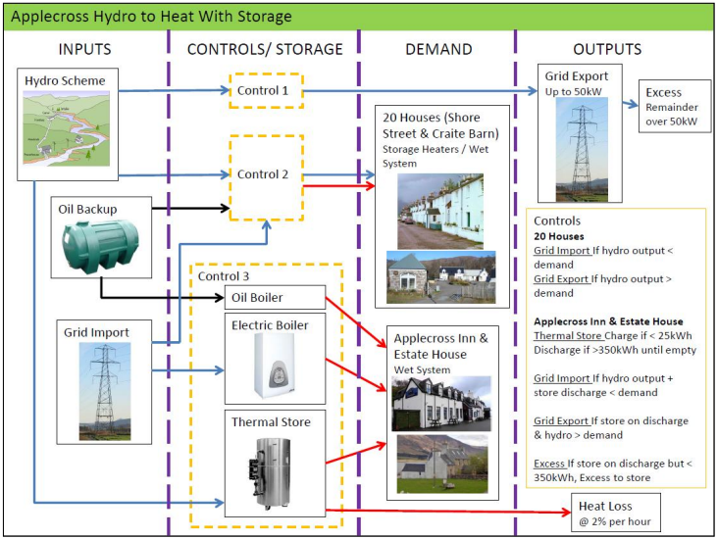
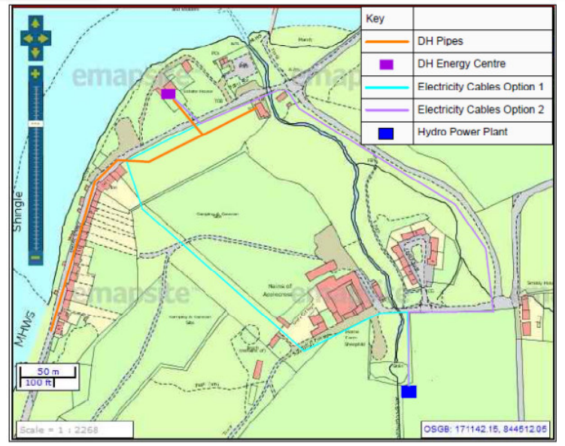
Applecross PWN
Notes:
For houses with electrical heating there would be a ‘smart’ switch on the heating circuit to allow a change from hydro supply to grid supply as required.
Advantages of PWN over DH:
Installation of infrastructure less disruptive i.e. no central energy centre building required
Electrical cabling less expensive than DHN insulated pipes
Less changes to existing heating systems required when considering all buildings (most buildings had electric heating)
Less energy loss in electrical transmission than heat transmission

Slide 46
Smart Electric Heating

Slide 47
Adding Smart Controls
Notes:
Show Fully Charged Mixergy video https://youtu.be/z1Z4JCoPAGc 3:20-11:56 and Sunamp video https://www.youtube.com/watch?v=9upXeTMHUqE from 5.45

Slide 48
Heat Storage
Notes:
Show Fully Charged Mixergy video https://youtu.be/z1Z4JCoPAGc 3:20-11:56 and Sunamp video https://www.youtube.com/watch?v=9upXeTMHUqE from 5.45

Slide 49
Community Energy Scotland
Empowering Communities, Improving Lives
Visit our Community Energy Futures webpage at: www.cef.scot
Follow us on Twitter @CES_Tweet
Follow us on Facebook @communityenergyscotland

